Slide 1
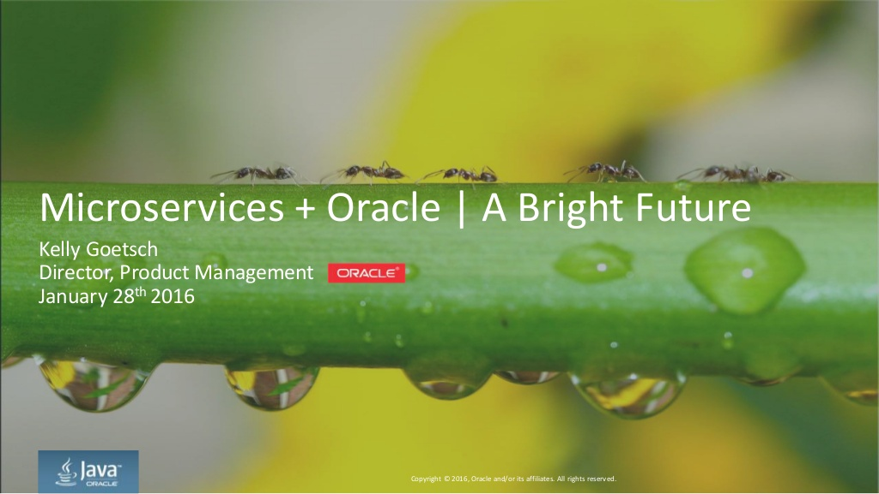
Notes:
Copyright Â© 2016, Oracle and/or its affiliates. All rights reserved. Microservices + Oracle | A Bright Future Kelly Goetsch Director, Product Management January 28th 2016

Slide 2
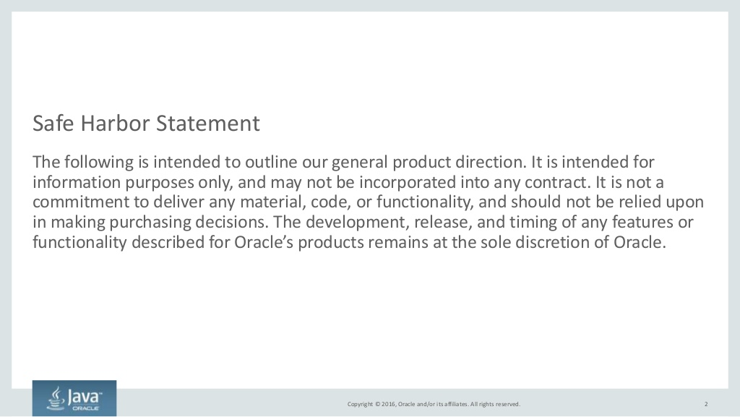
Notes:
Copyright Â© 2016, Oracle and/or its affiliates. All rights reserved. Safe Harbor Statement The following is intended to outline our general product direction. It is intended for information purposes only, and may not be incorporated into any contract. It is not a commitment to deliver any material, code, or functionality, and should not be relied upon in making purchasing decisions. The development, release, and timing of any features or functionality described for Oracles products remains at the sole discretion of Oracle. 2

Slide 3
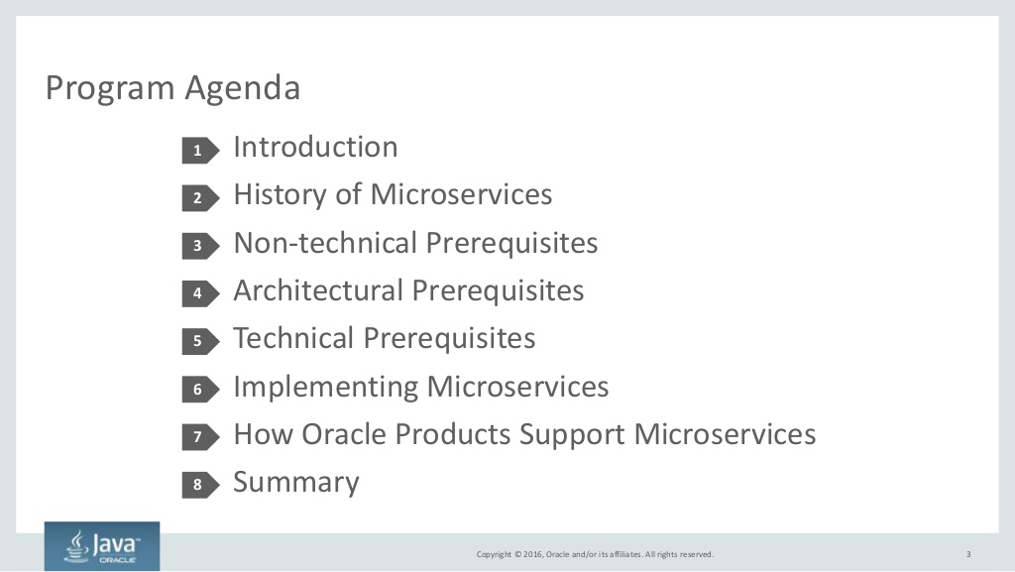
Notes:
Copyright Â© 2016, Oracle and/or its affiliates. All rights reserved. Program Agenda Introduction History of Microservices Non-technical Prerequisites Architectural Prerequisites Technical Prerequisites Implementing Microservices How Oracle Products Support Microservices Summary 1 2 3 4 5 3 6 7 8

Slide 4
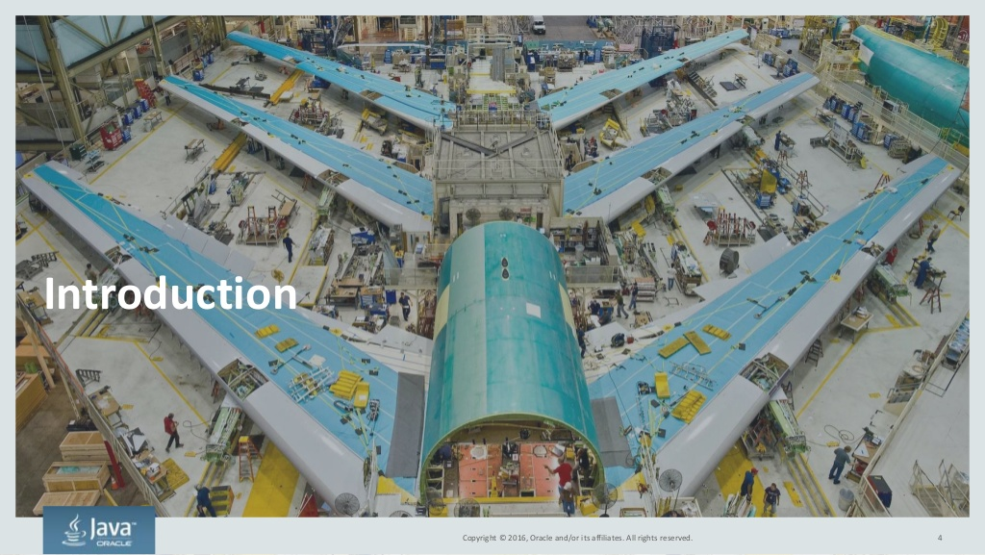
Notes:
Copyright Â© 2016, Oracle and/or its affiliates. All rights reserved. Introduction 4

Slide 5
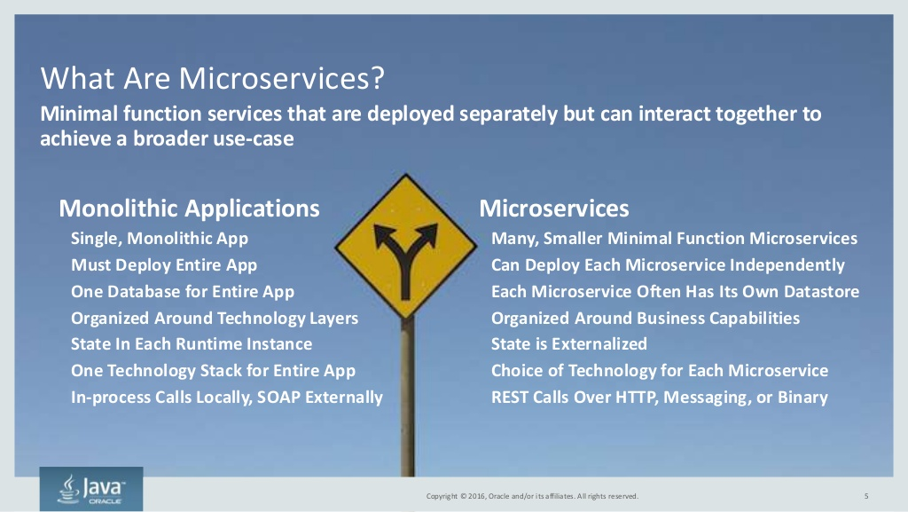
Notes:
Copyright Â© 2016, Oracle and/or its affiliates. All rights reserved. 5 Monolithic Applications Single, Monolithic App Must Deploy Entire App One Database for Entire App Organized Around Technology Layers State In Each Runtime Instance One Technology Stack for Entire App In-process Calls Locally, SOAP Externally Microservices Many, Smaller Minimal Function Microservices Can Deploy Each Microservice Independently Each Microservice Often Has Its Own Datastore Organized Around Business Capabilities State is Externalized Choice of Technology for Each Microservice REST Calls Over HTTP, Messaging, or Binary What Are Microservices? Minimal function services that are deployed separately but can interact together to achieve a broader use-case Copyright Â© 2016, Oracle and/or its affiliates. All rights reserved.

Slide 6
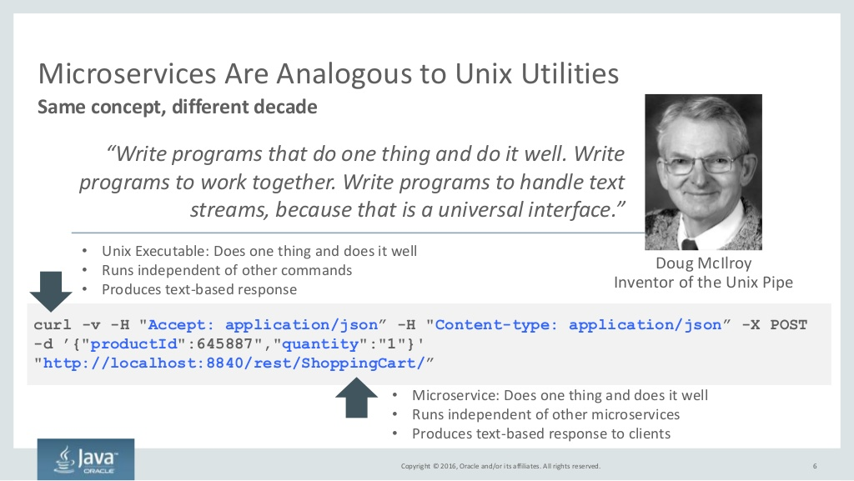
Notes:
Copyright Â© 2016, Oracle and/or its affiliates. All rights reserved. Microservices Are Analogous to Unix Utilities 6 Same concept, different decade Doug McIlroy Inventor of the Unix Pipe Write programs that do one thing and do it well. Write programs to work together. Write programs to handle text streams, because that is a universal interface. curl -v -H &Accept: application/json -H &Content-type: application/json -X POST -d {&productId&:645887&,&quantity&:&1&}&#x27; &http://localhost:8840/rest/ShoppingCart/ - Unix Executable: Does one thing and does it well - Runs independent of other commands - Produces text-based response - Microservice: Does one thing and does it well - Runs independent of other microservices - Produces text-based response to clients

Slide 7
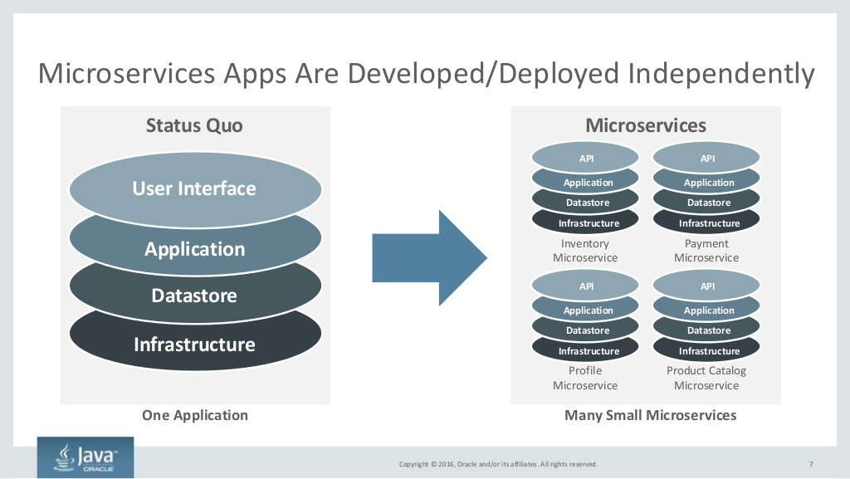
Notes:
Copyright Â© 2016, Oracle and/or its affiliates. All rights reserved. Microservices Apps Are Developed/Deployed Independently 7 User Interface Application Datastore Infrastructure Status Quo One Application Microservices Many Small Microservices API Application Datastore Infrastructure Inventory Microservice API Application Datastore Infrastructure Payment Microservice API Application Datastore Infrastructure Profile Microservice API Application Datastore Infrastructure Product Catalog Microservice

Slide 8
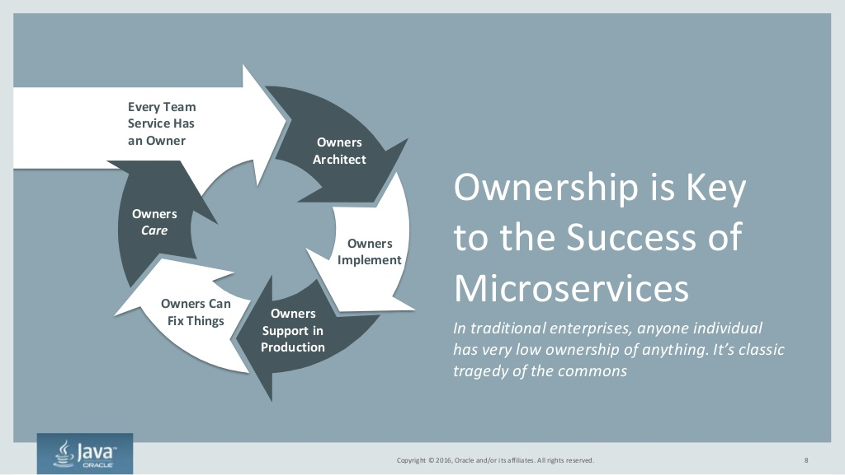
Notes:
Copyright Â© 2016, Oracle and/or its affiliates. All rights reserved. Owners Support in Production Every Team Service Has an Owner Owners Implement Owners Architect Owners Care Owners Can Fix Things Ownership is Key to the Success of Microservices In traditional enterprises, anyone individual has very low ownership of anything. Its classic tragedy of the commons 8Copyright Â© 2016, Oracle and/or its affiliates. All rights reserved.

Slide 9
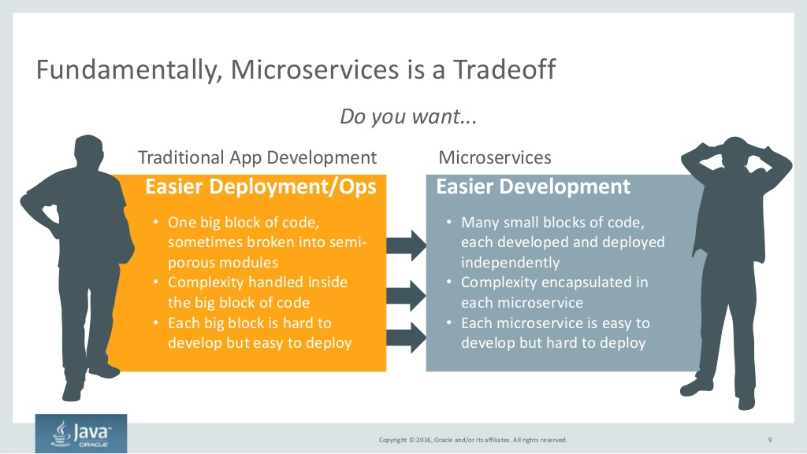
Notes:
Copyright Â© 2016, Oracle and/or its affiliates. All rights reserved. Fundamentally, Microservices is a Tradeoff 9 Easier Deployment/Ops Easier Development Do you want... Traditional App Development Microservices - One big block of code, sometimes broken into semi- porous modules - Complexity handled inside the big block of code - Each big block is hard to develop but easy to deploy - Many small blocks of code, each developed and deployed independently - Complexity encapsulated in each microservice - Each microservice is easy to develop but hard to deploy

Slide 10
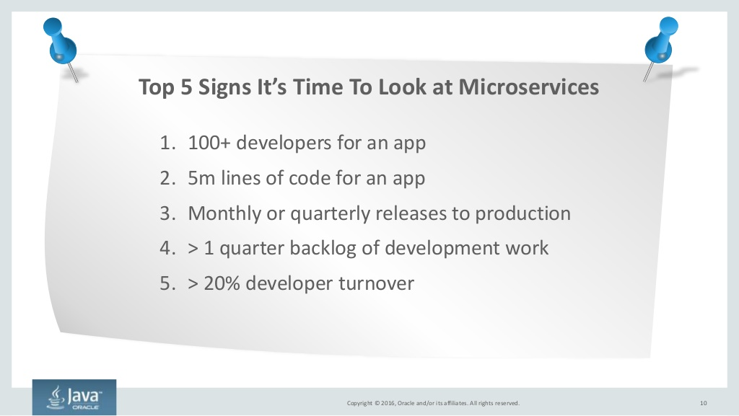
Notes:
Copyright Â© 2016, Oracle and/or its affiliates. All rights reserved. 10 1. 100+ developers for an app 2. 5m lines of code for an app 3. Monthly or quarterly releases to production 4. &> 1 quarter backlog of development work 5. &> 20% developer turnover Top 5 Signs Its Time To Look at Microservices

Slide 11
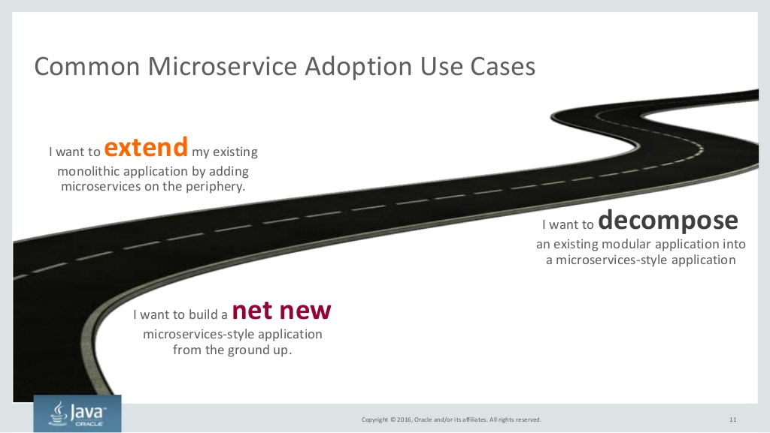
Notes:
Copyright Â© 2016, Oracle and/or its affiliates. All rights reserved. Common Microservice Adoption Use Cases 11 I want to extendmy existing monolithic application by adding microservices on the periphery. I want to decompose an existing modular application into a microservices-style application I want to build a net new microservices-style application from the ground up.

Slide 12
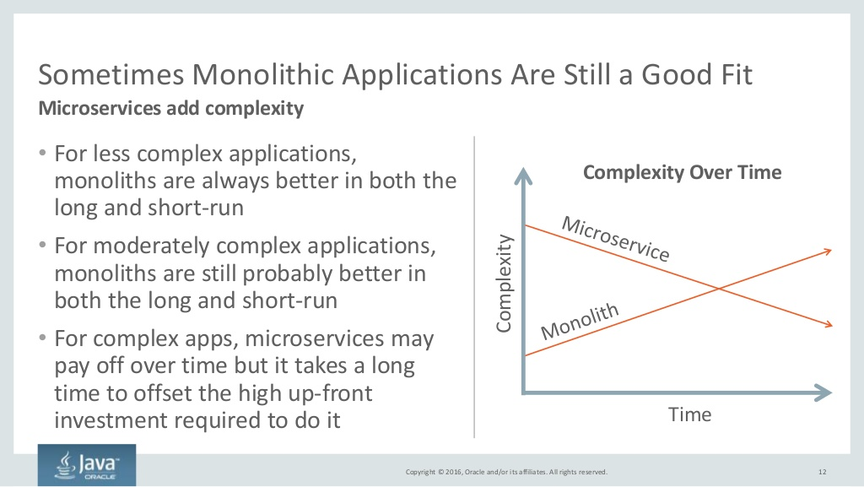
Notes:
Copyright Â© 2016, Oracle and/or its affiliates. All rights reserved. Sometimes Monolithic Applications Are Still a Good Fit - For less complex applications, monoliths are always better in both the long and short-run - For moderately complex applications, monoliths are still probably better in both the long and short-run - For complex apps, microservices may pay off over time but it takes a long time to offset the high up-front investment required to do it 12 Microservices add complexity Time Complexity Complexity Over Time

Slide 13
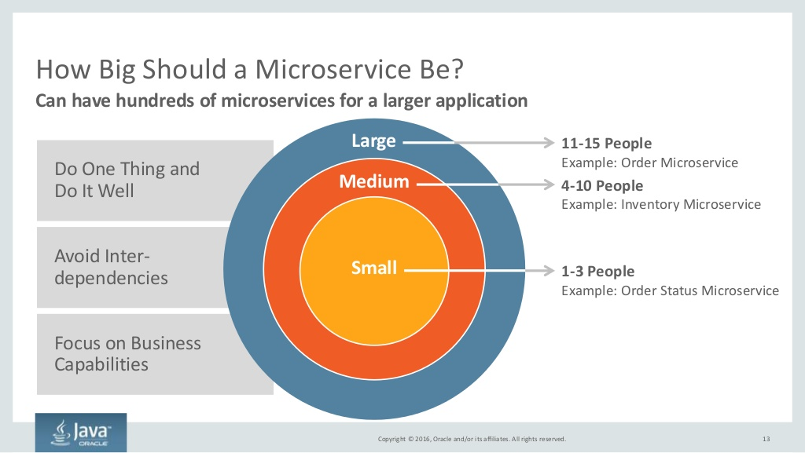
Notes:
Copyright Â© 2016, Oracle and/or its affiliates. All rights reserved. Do One Thing and Do It Well Focus on Business Capabilities Avoid Inter- dependencies How Big Should a Microservice Be? Can have hundreds of microservices for a larger application Large Medium Small 11-15 People Example: Order Microservice 4-10 People Example: Inventory Microservice 1-3 People Example: Order Status Microservice 13

Slide 14
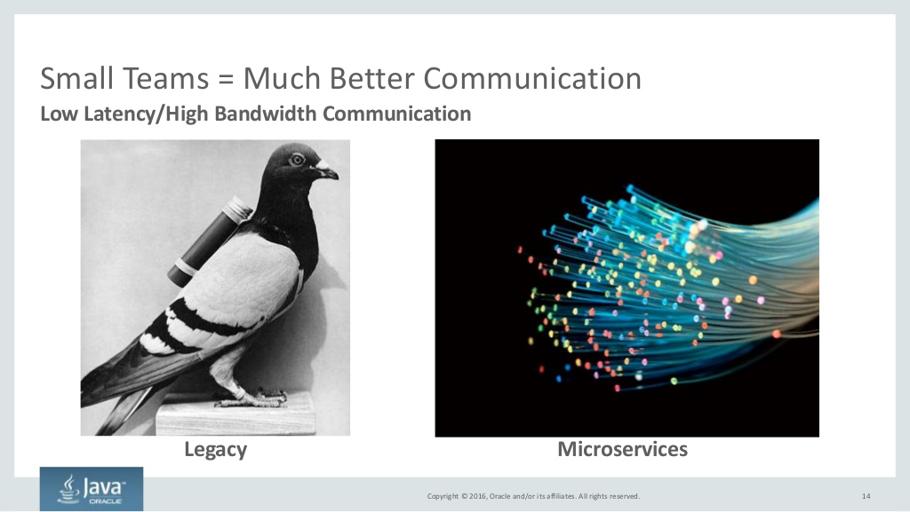
Notes:
Copyright Â© 2016, Oracle and/or its affiliates. All rights reserved. Small Teams = Much Better Communication 14 Low Latency/High Bandwidth Communication Legacy Microservices

Slide 15
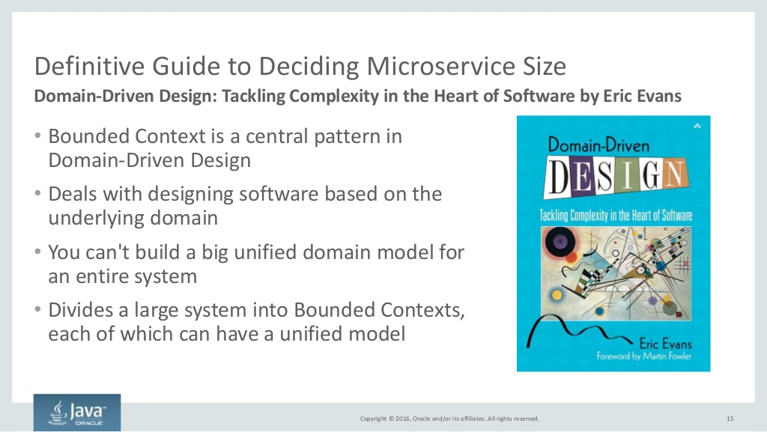
Notes:
Copyright Â© 2016, Oracle and/or its affiliates. All rights reserved. Definitive Guide to Deciding Microservice Size - Bounded Context is a central pattern in Domain-Driven Design - Deals with designing software based on the underlying domain - You can&#x27;t build a big unified domain model for an entire system - Divides a large system into Bounded Contexts, each of which can have a unified model 15 Domain-Driven Design: Tackling Complexity in the Heart of Software by Eric Evans

Slide 16
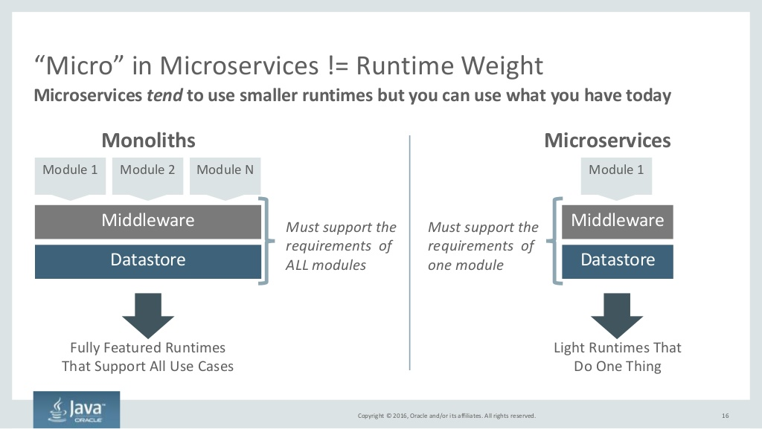
Notes:
Copyright Â© 2016, Oracle and/or its affiliates. All rights reserved. Micro in Microservices != Runtime Weight 16 Microservices tend to use smaller runtimes but you can use what you have today Middleware Module 1 Module 2 Module N Datastore Must support the requirements of ALL modules Fully Featured Runtimes That Support All Use Cases Middleware Module 1 Datastore Must support the requirements of one module Light Runtimes That Do One Thing Monoliths Microservices

Slide 17
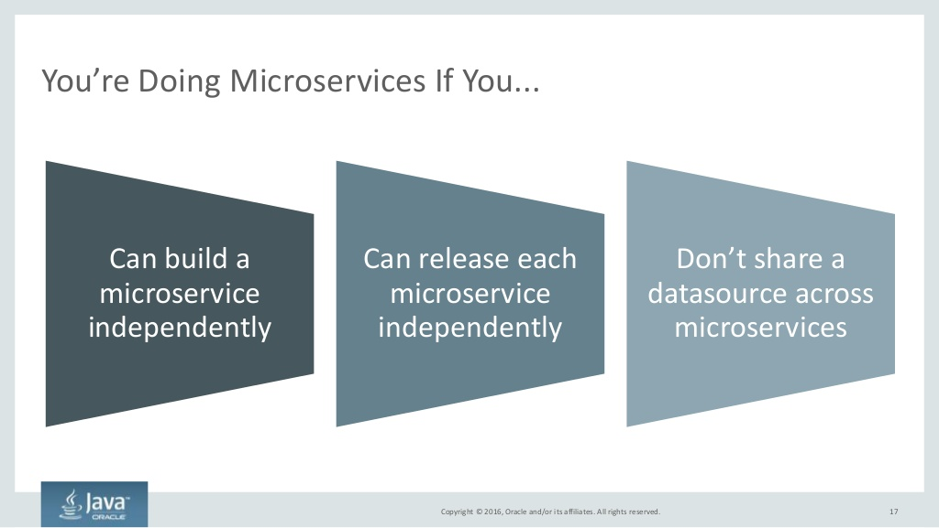
Notes:
Copyright Â© 2016, Oracle and/or its affiliates. All rights reserved. Youre Doing Microservices If You... 17 Can build a microservice independently Can release each microservice independently Dont share a datasource across microservices

Slide 18
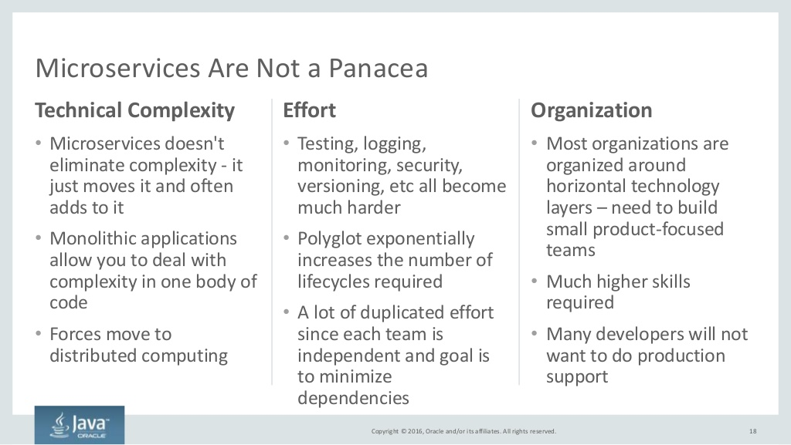
Notes:
Copyright Â© 2016, Oracle and/or its affiliates. All rights reserved. Technical Complexity - Microservices doesn&#x27;t eliminate complexity - it just moves it and often adds to it - Monolithic applications allow you to deal with complexity in one body of code - Forces move to distributed computing Effort - Testing, logging, monitoring, security, versioning, etc all become much harder - Polyglot exponentially increases the number of lifecycles required - A lot of duplicated effort since each team is independent and goal is to minimize dependencies 18 Organization - Most organizations are organized around horizontal technology layers  need to build small product-focused teams - Much higher skills required - Many developers will not want to do production support Microservices Are Not a Panacea

Slide 19
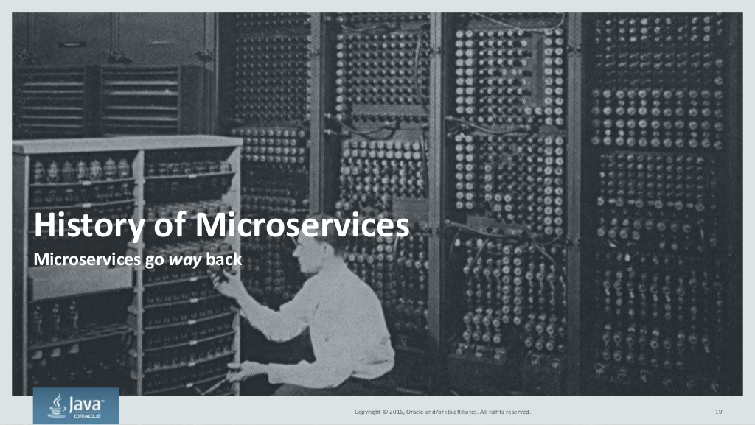
Notes:
Copyright Â© 2016, Oracle and/or its affiliates. All rights reserved. History of Microservices Microservices go way back 19

Slide 20
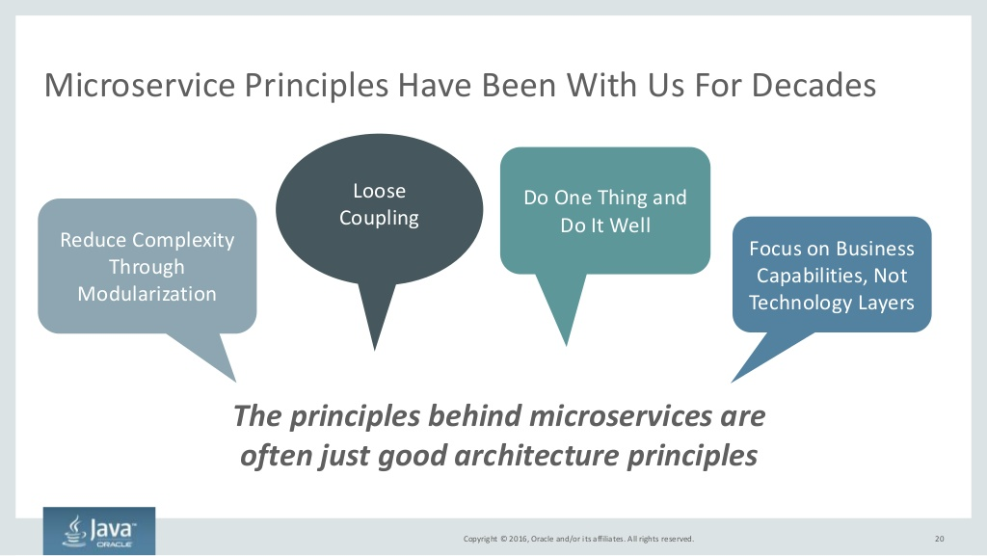
Notes:
Copyright Â© 2016, Oracle and/or its affiliates. All rights reserved. Microservice Principles Have Been With Us For Decades 20 The principles behind microservices are often just good architecture principles Loose Coupling Focus on Business Capabilities, Not Technology Layers Reduce Complexity Through Modularization Do One Thing and Do It Well

Slide 21
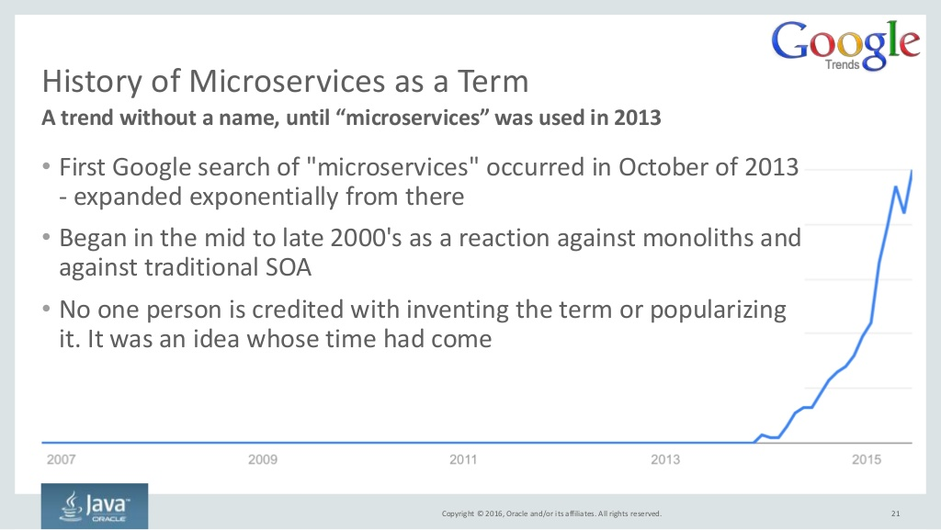
Notes:
Copyright Â© 2016, Oracle and/or its affiliates. All rights reserved. History of Microservices as a Term - First Google search of &microservices& occurred in October of 2013 - expanded exponentially from there - Began in the mid to late 2000&#x27;s as a reaction against monoliths and against traditional SOA - No one person is credited with inventing the term or popularizing it. It was an idea whose time had come 21 A trend without a name, until microservices was used in 2013

Slide 22
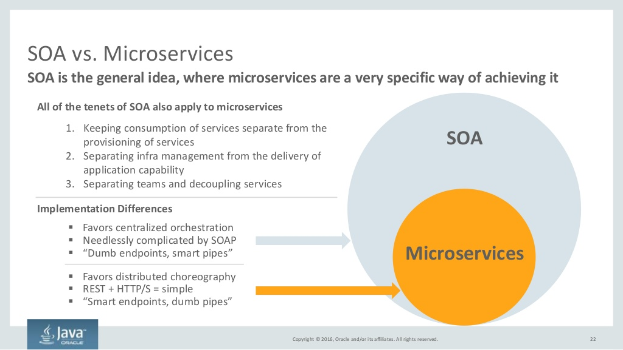
Notes:
Copyright Â© 2016, Oracle and/or its affiliates. All rights reserved. SOA vs. Microservices 22 SOA is the general idea, where microservices are a very specific way of achieving it ï§ Favors centralized orchestration ï§ Needlessly complicated by SOAP ï§ Dumb endpoints, smart pipes SOA Microservices ï§ Favors distributed choreography ï§ REST + HTTP/S = simple ï§ Smart endpoints, dumb pipes 1. Keeping consumption of services separate from the provisioning of services 2. Separating infra management from the delivery of application capability 3. Separating teams and decoupling services Implementation Differences All of the tenets of SOA also apply to microservices

Slide 23
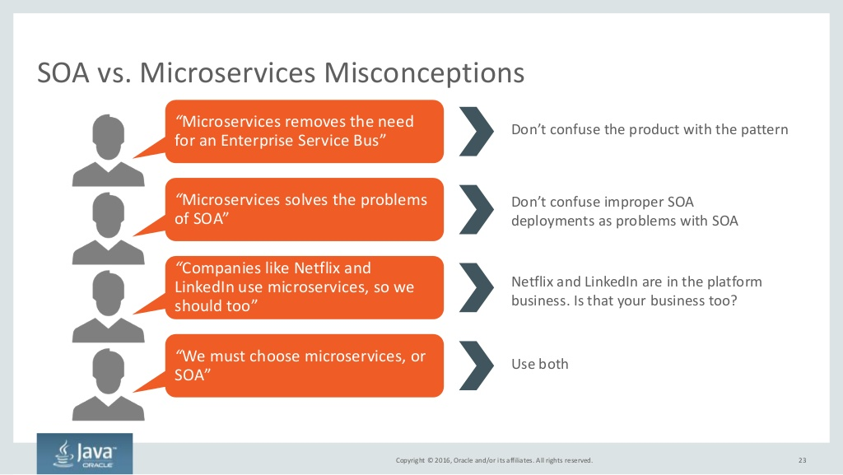
Notes:
Copyright Â© 2016, Oracle and/or its affiliates. All rights reserved. SOA vs. Microservices Misconceptions 23 Microservices removes the need for an Enterprise Service Bus Dont confuse the product with the pattern Microservices solves the problems of SOA Dont confuse improper SOA deployments as problems with SOA Companies like Netflix and LinkedIn use microservices, so we should too Netflix and LinkedIn are in the platform business. Is that your business too? We must choose microservices, or SOA Use both

Slide 24
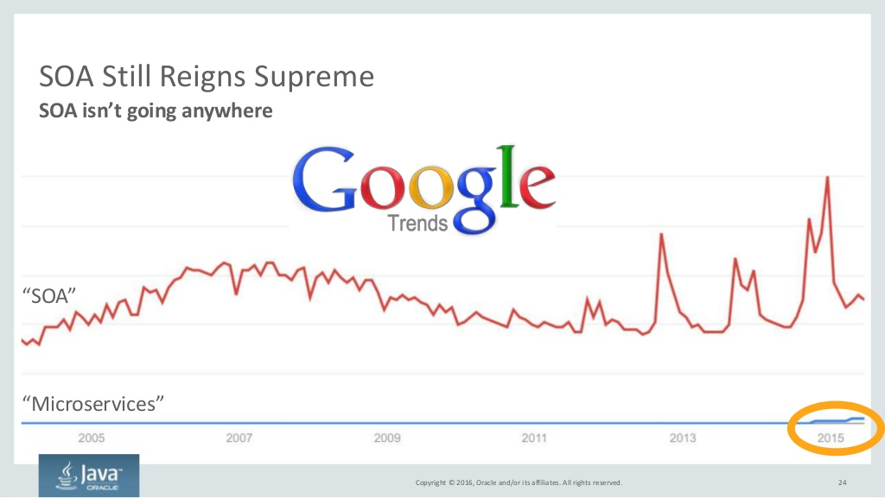
Notes:
Copyright Â© 2016, Oracle and/or its affiliates. All rights reserved. SOA Still Reigns Supreme 24 SOA isnt going anywhere Microservices SOA

Slide 25
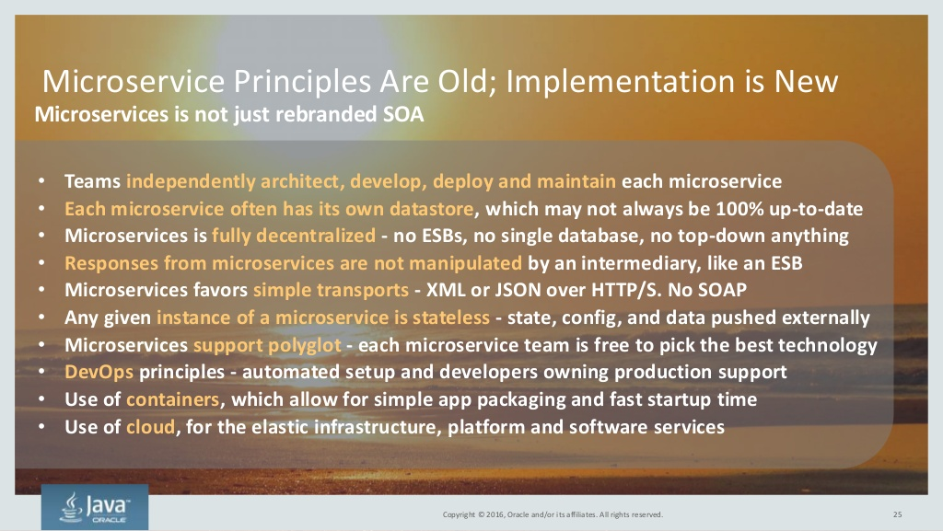
Notes:
Copyright Â© 2016, Oracle and/or its affiliates. All rights reserved. 25 Microservice Principles Are Old; Implementation is New Microservices is not just rebranded SOA - Teams independently architect, develop, deploy and maintain each microservice - Each microservice often has its own datastore, which may not always be 100% up-to-date - Microservices is fully decentralized - no ESBs, no single database, no top-down anything - Responses from microservices are not manipulated by an intermediary, like an ESB - Microservices favors simple transports - XML or JSON over HTTP/S. No SOAP - Any given instance of a microservice is stateless - state, config, and data pushed externally - Microservices support polyglot - each microservice team is free to pick the best technology - DevOps principles - automated setup and developers owning production support - Use of containers, which allow for simple app packaging and fast startup time - Use of cloud, for the elastic infrastructure, platform and software services

Slide 26
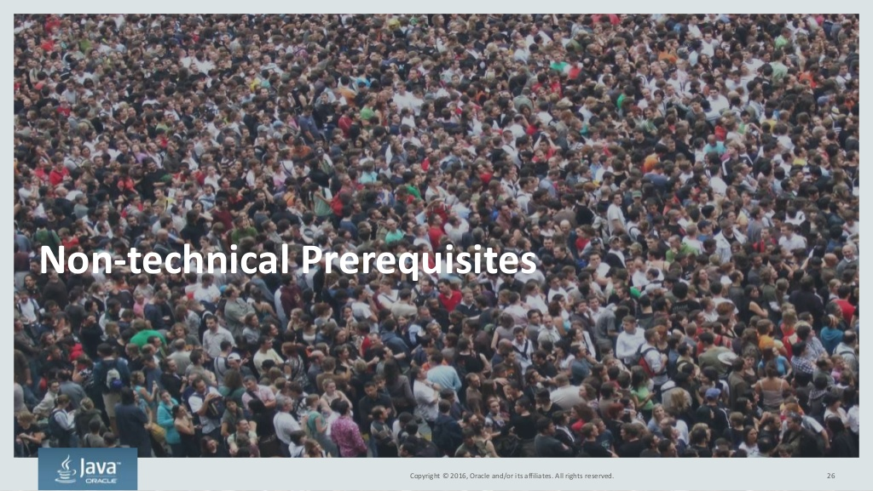
Notes:
Copyright Â© 2016, Oracle and/or its affiliates. All rights reserved. Non-technical Prerequisites 26

Slide 27
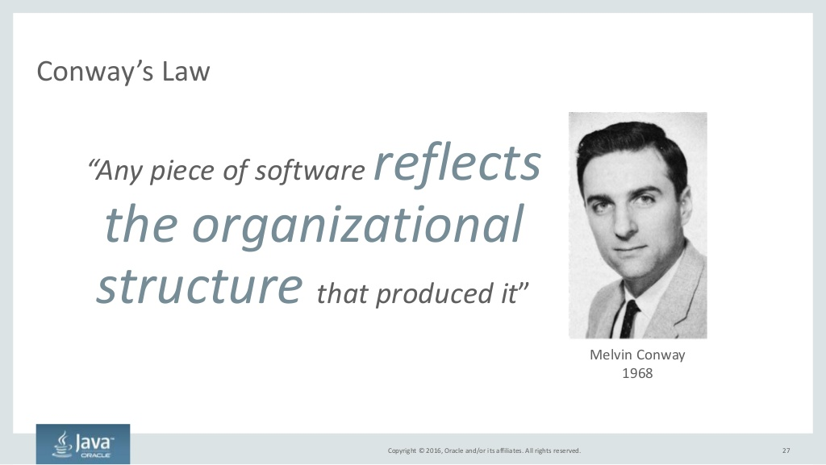
Notes:
Copyright Â© 2016, Oracle and/or its affiliates. All rights reserved. Conways Law 27 Any piece of software reflects the organizational structure that produced it Melvin Conway 1968

Slide 28
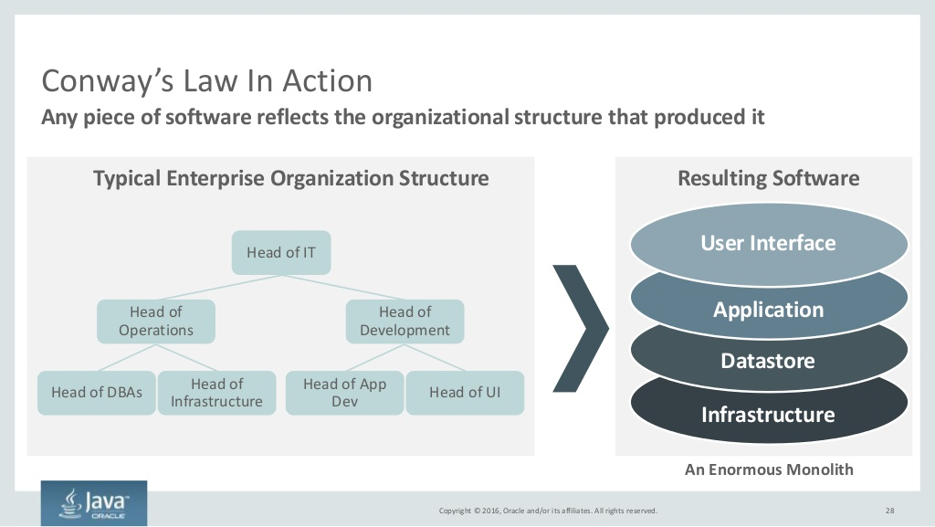
Notes:
Copyright Â© 2016, Oracle and/or its affiliates. All rights reserved. Conways Law In Action 28 Any piece of software reflects the organizational structure that produced it User Interface Application Datastore Infrastructure Resulting SoftwareTypical Enterprise Organization Structure Head of IT Head of Operations Head of DBAs Head of Infrastructure Head of App Dev Head of UI Head of Development An Enormous Monolith

Slide 29
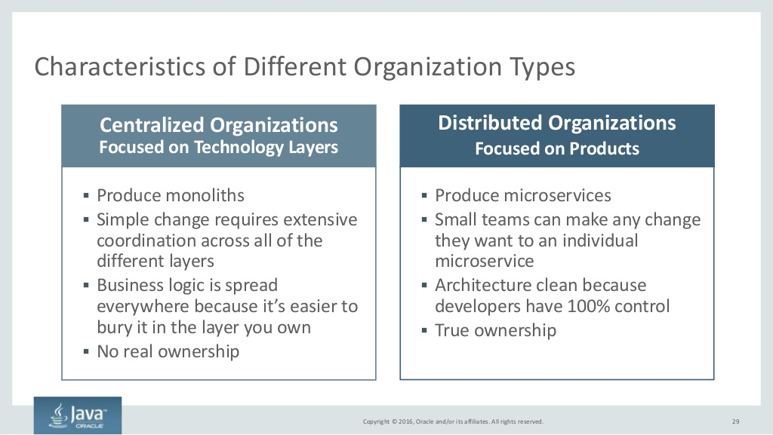
Notes:
Copyright Â© 2016, Oracle and/or its affiliates. All rights reserved. Characteristics of Different Organization Types 29 ï§ Produce microservices ï§ Small teams can make any change they want to an individual microservice ï§ Architecture clean because developers have 100% control ï§ True ownership ï§ Produce monoliths ï§ Simple change requires extensive coordination across all of the different layers ï§ Business logic is spread everywhere because its easier to bury it in the layer you own ï§ No real ownership Centralized Organizations Focused on Technology Layers Distributed Organizations Focused on Products

Slide 30
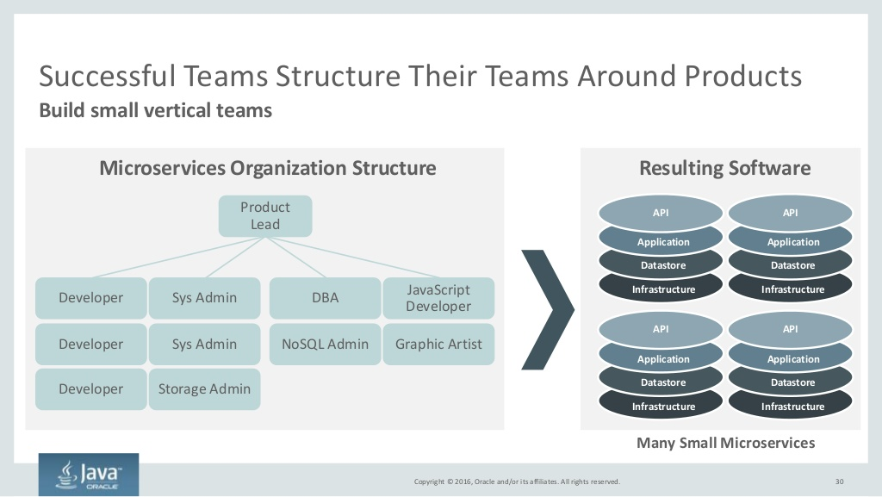
Notes:
Copyright Â© 2016, Oracle and/or its affiliates. All rights reserved. Successful Teams Structure Their Teams Around Products 30 Build small vertical teams Resulting SoftwareMicroservices Organization Structure Product Lead Developer Sys Admin DBA JavaScript Developer Many Small Microservices Developer Developer Sys Admin Storage Admin Graphic ArtistNoSQL Admin API Application Datastore Infrastructure API Application Datastore Infrastructure API Application Datastore Infrastructure API Application Datastore Infrastructure

Slide 31
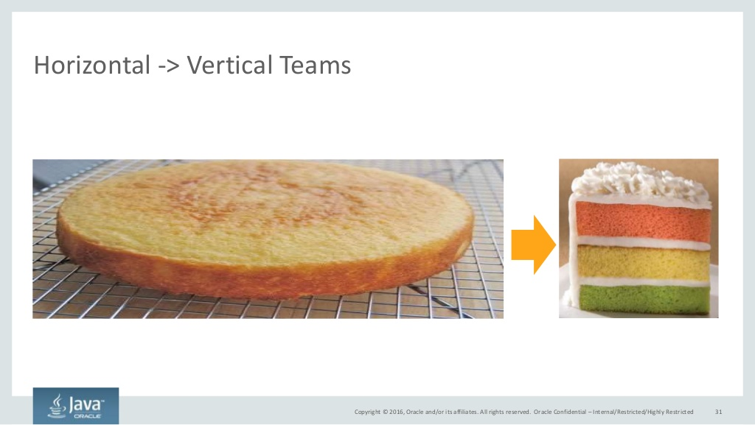
Notes:
Copyright Â© 2016, Oracle and/or its affiliates. All rights reserved. Horizontal -&> Vertical Teams Oracle Confidential  Internal/Restricted/Highly Restricted 31

Slide 32
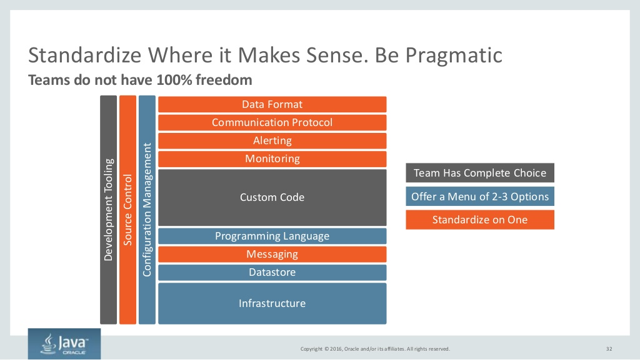
Notes:
Copyright Â© 2016, Oracle and/or its affiliates. All rights reserved. Standardize Where it Makes Sense. Be Pragmatic 32 Teams do not have 100% freedom Custom Code Communication Protocol Data Format Infrastructure Datastore SourceControl ConfigurationManagement DevelopmentTooling Alerting Monitoring Standardize on One Offer a Menu of 2-3 Options Team Has Complete Choice Programming Language Messaging

Slide 33
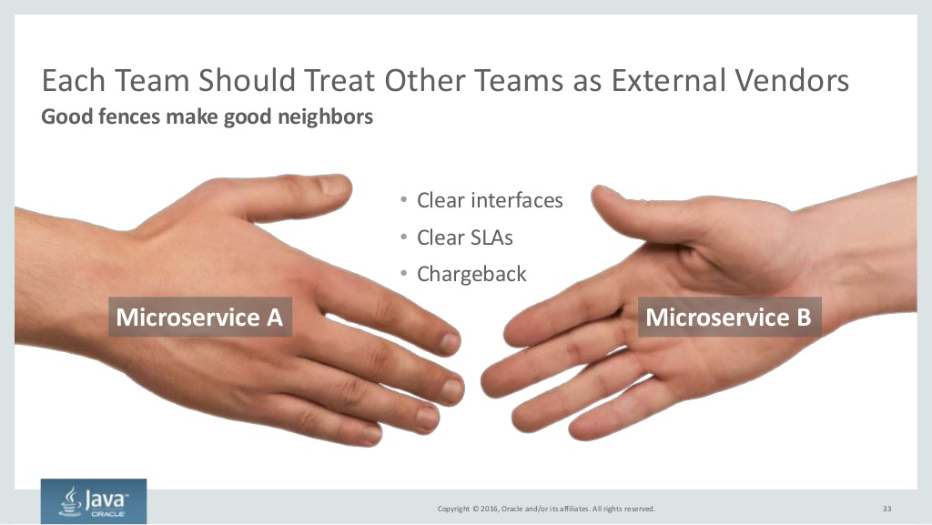
Notes:
Copyright Â© 2016, Oracle and/or its affiliates. All rights reserved. Each Team Should Treat Other Teams as External Vendors - Clear interfaces - Clear SLAs - Chargeback 33 Good fences make good neighbors Microservice A Microservice B

Slide 34
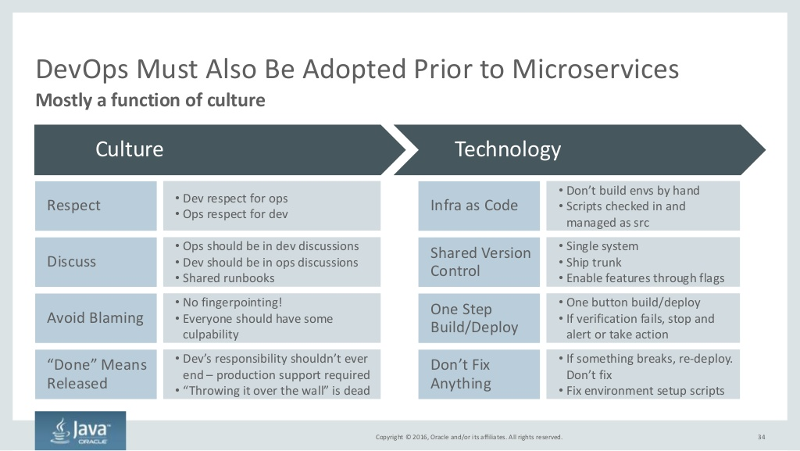
Notes:
Copyright Â© 2016, Oracle and/or its affiliates. All rights reserved. DevOps Must Also Be Adopted Prior to Microservices 34 Mostly a function of culture Culture Technology Respect Discuss Avoid Blaming Done Means Released Infra as Code Shared Version Control One Step Build/Deploy Dont Fix Anything - Dev respect for ops - Ops respect for dev - Ops should be in dev discussions - Dev should be in ops discussions - Shared runbooks - No fingerpointing! - Everyone should have some culpability - Devs responsibility shouldnt ever end  production support required - Throwing it over the wall is dead - Dont build envs by hand - Scripts checked in and managed as src - Single system - Ship trunk - Enable features through flags - One button build/deploy - If verification fails, stop and alert or take action - If something breaks, re-deploy. Dont fix - Fix environment setup scripts

Slide 35
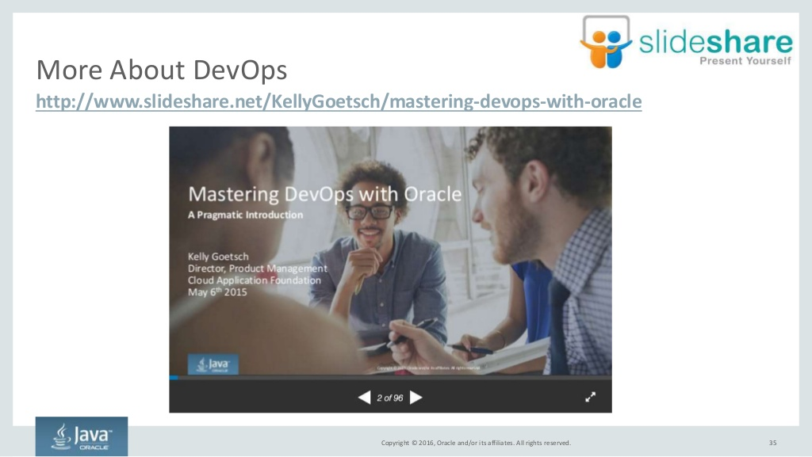
Notes:
Copyright Â© 2016, Oracle and/or its affiliates. All rights reserved. 35 More About DevOps http://www.slideshare.net/KellyGoetsch/mastering-devops-with-oracle

Slide 36
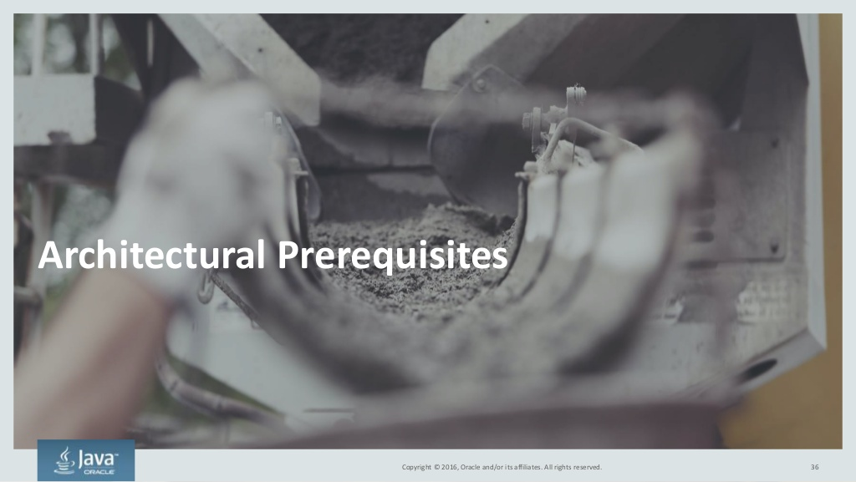
Notes:
Copyright Â© 2016, Oracle and/or its affiliates. All rights reserved. Architectural Prerequisites 36

Slide 37
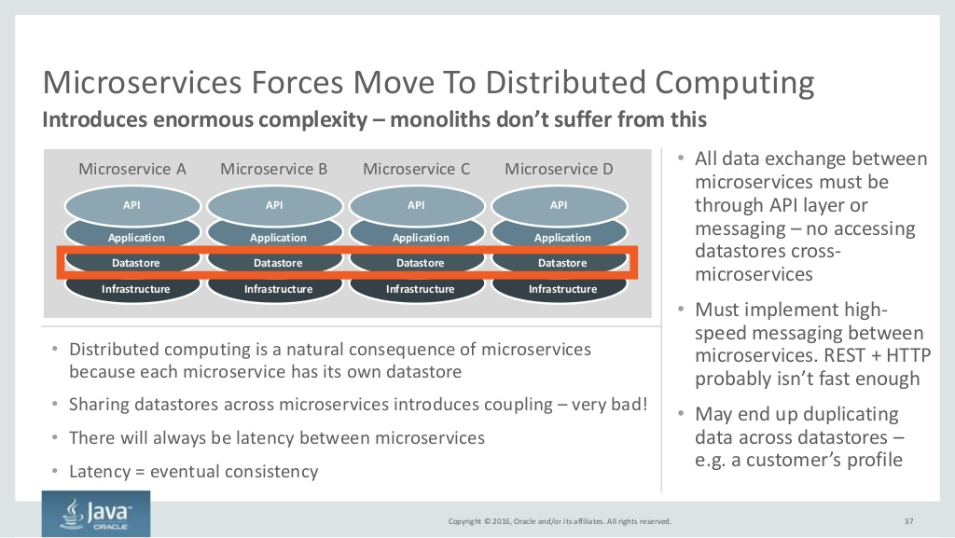
Notes:
Copyright Â© 2016, Oracle and/or its affiliates. All rights reserved. Microservices Forces Move To Distributed Computing 37 Introduces enormous complexity  monoliths dont suffer from this API Application Datastore Infrastructure API Application Datastore Infrastructure API Application Datastore Infrastructure API Application Datastore Infrastructure Microservice A Microservice B Microservice C Microservice D - Distributed computing is a natural consequence of microservices because each microservice has its own datastore - Sharing datastores across microservices introduces coupling  very bad! - There will always be latency between microservices - Latency = eventual consistency - All data exchange between microservices must be through API layer or messaging  no accessing datastores cross- microservices - Must implement high- speed messaging between microservices. REST + HTTP probably isnt fast enough - May end up duplicating data across datastores  e.g. a customers profile

Slide 38
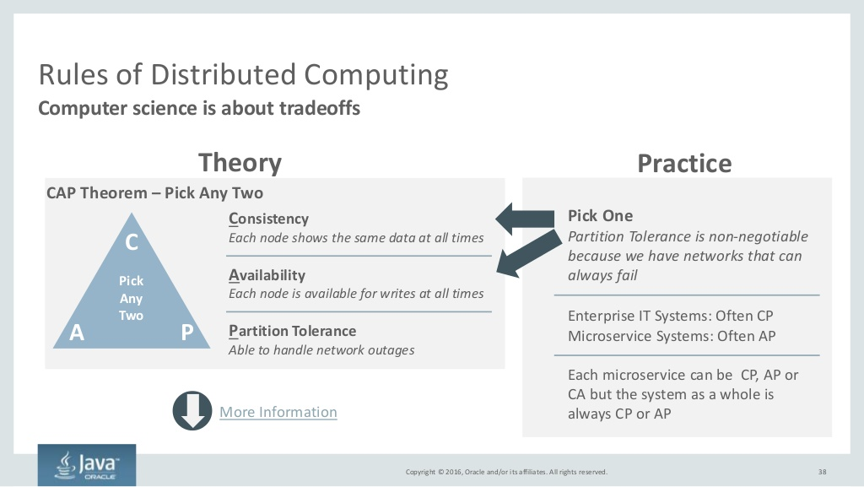
Notes:
Copyright Â© 2016, Oracle and/or its affiliates. All rights reserved. Rules of Distributed Computing 38 Computer science is about tradeoffs Consistency Each node shows the same data at all times Availability Each node is available for writes at all times Partition Tolerance Able to handle network outages CAP Theorem  Pick Any Two C A P Theory Practice Pick One Partition Tolerance is non-negotiable because we have networks that can always fail Enterprise IT Systems: Often CP Microservice Systems: Often AP Each microservice can be CP, AP or CA but the system as a whole is always CP or APMore Information Pick Any Two

Slide 39
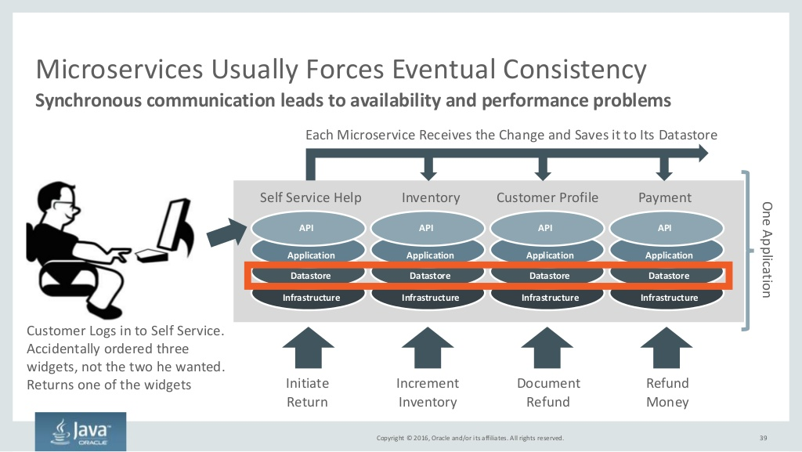
Notes:
Copyright Â© 2016, Oracle and/or its affiliates. All rights reserved. Microservices Usually Forces Eventual Consistency 39 Synchronous communication leads to availability and performance problems API Application Datastore Infrastructure API Application Datastore Infrastructure API Application Datastore Infrastructure API Application Datastore Infrastructure Self Service Help Inventory Customer Profile Payment Initiate Return Increment Inventory Document Refund Refund Money Customer Logs in to Self Service. Accidentally ordered three widgets, not the two he wanted. Returns one of the widgets Each Microservice Receives the Change and Saves it to Its Datastore OneApplication

Slide 40
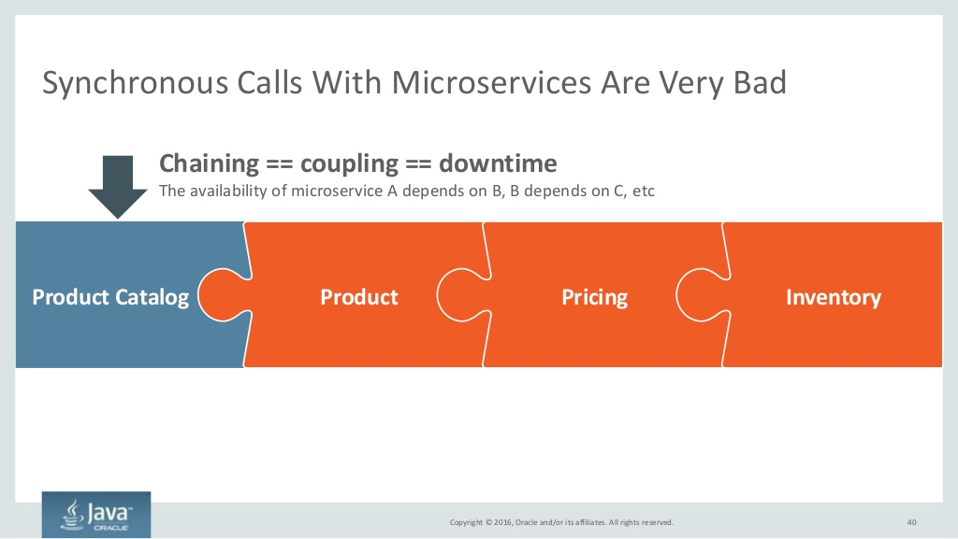
Notes:
Copyright Â© 2016, Oracle and/or its affiliates. All rights reserved. Synchronous Calls With Microservices Are Very Bad 40 Product Catalog Product Pricing Inventory Chaining == coupling == downtime The availability of microservice A depends on B, B depends on C, etc

Slide 41
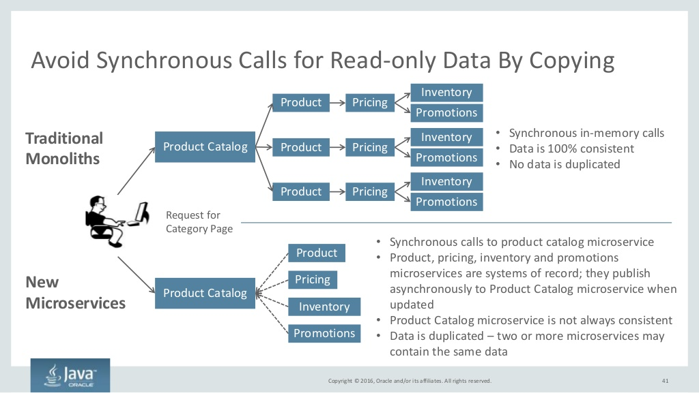
Notes:
Copyright Â© 2016, Oracle and/or its affiliates. All rights reserved. Avoid Synchronous Calls for Read-only Data By Copying 41 Product Pricing Inventory Promotions Product Pricing Inventory Promotions Product Pricing Inventory Promotions Product Catalog - Synchronous in-memory calls - Data is 100% consistent - No data is duplicated Request for Category Page Product Catalog Product Pricing Inventory Promotions - Synchronous calls to product catalog microservice - Product, pricing, inventory and promotions microservices are systems of record; they publish asynchronously to Product Catalog microservice when updated - Product Catalog microservice is not always consistent - Data is duplicated  two or more microservices may contain the same data Traditional Monoliths New Microservices

Slide 42
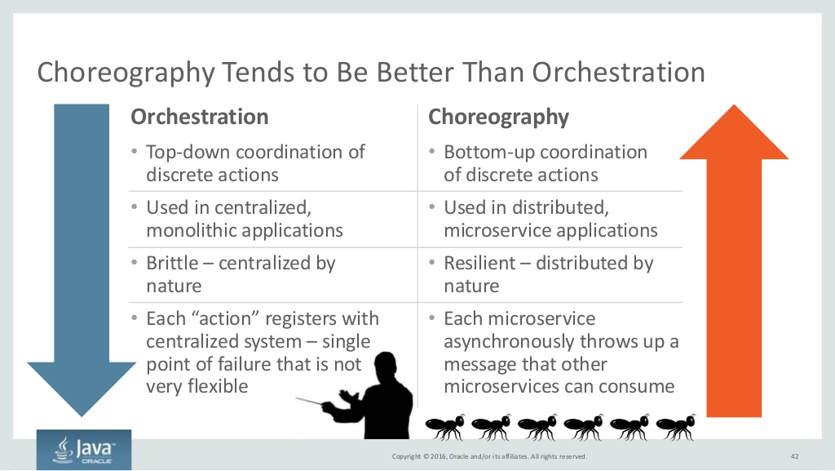
Notes:
Copyright Â© 2016, Oracle and/or its affiliates. All rights reserved. Orchestration - Top-down coordination of discrete actions - Used in centralized, monolithic applications - Brittle  centralized by nature - Each action registers with centralized system  single point of failure that is not very flexible Choreography - Bottom-up coordination of discrete actions - Used in distributed, microservice applications - Resilient  distributed by nature - Each microservice asynchronously throws up a message that other microservices can consume 42 Choreography Tends to Be Better Than Orchestration

Slide 43
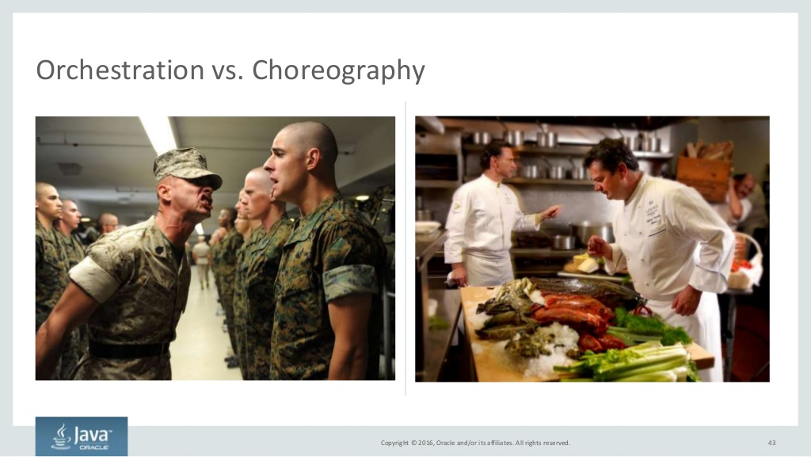
Notes:
Copyright Â© 2016, Oracle and/or its affiliates. All rights reserved. 43 Orchestration vs. Choreography

Slide 44
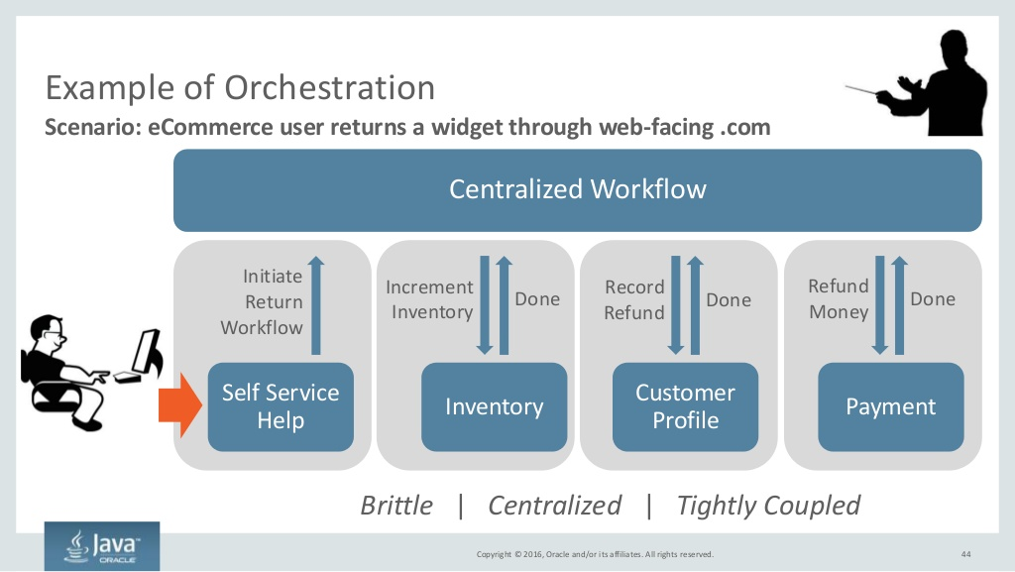
Notes:
Copyright Â© 2016, Oracle and/or its affiliates. All rights reserved. 44 Scenario: eCommerce user returns a widget through web-facing .com Example of Orchestration Centralized Workflow Self Service Help Initiate Return Workflow Increment Inventory Done Inventory Record Refund Done Customer Profile Done Payment Refund Money Brittle | Centralized | Tightly Coupled

Slide 45
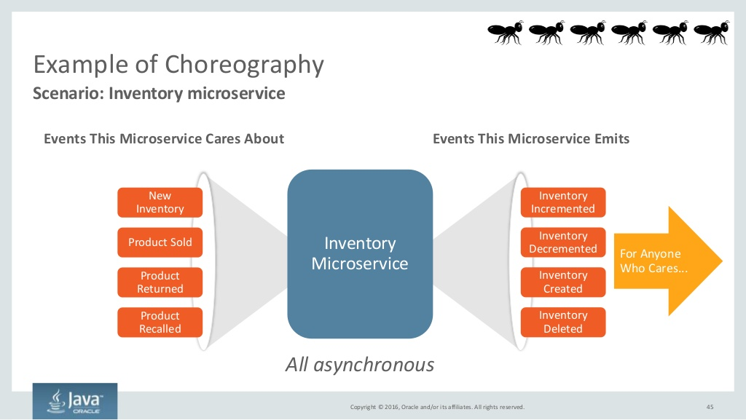
Notes:
Copyright Â© 2016, Oracle and/or its affiliates. All rights reserved. 45 Scenario: Inventory microservice Example of Choreography Inventory Microservice All asynchronous Event Bus New Inventory Events This Microservice Cares About Events This Microservice Emits Product Returned Product Sold Product Recalled Inventory Incremented Inventory Created Inventory Decremented Inventory Deleted For Anyone Who Cares...

Slide 46
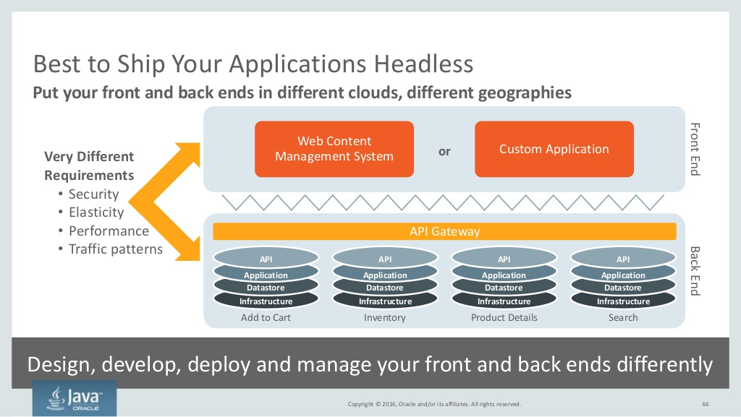
Notes:
Copyright Â© 2016, Oracle and/or its affiliates. All rights reserved. Best to Ship Your Applications Headless Put your front and back ends in different clouds, different geographies Design, develop, deploy and manage your front and back ends differently 46 API Application Datastore Infrastructure API Application Datastore Infrastructure API Application Datastore Infrastructure API Application Datastore Infrastructure BackEnd Add to Cart Inventory Product Details Search FrontEnd API Gateway Web Content Management System Custom Application Very Different Requirements - Security - Elasticity - Performance - Traffic patterns or Copyright Â© 2016, Oracle and/or its affiliates. All rights reserved.

Slide 47
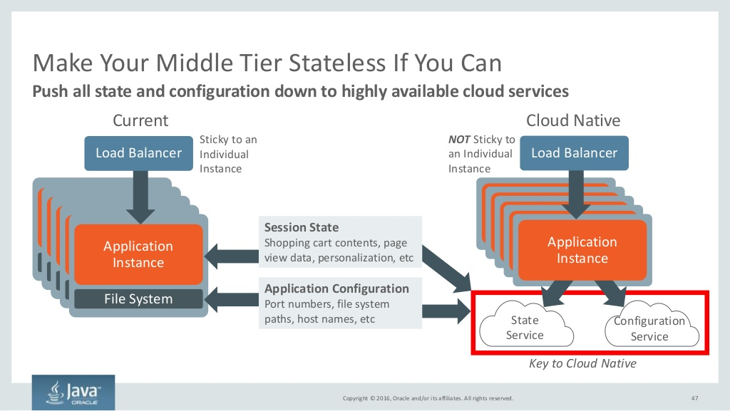
Notes:
Copyright Â© 2016, Oracle and/or its affiliates. All rights reserved. Make Your Middle Tier Stateless If You Can 47 Push all state and configuration down to highly available cloud services Application Server File System Application Server File System Application Server File System Application Server File System Application Instance File System Load Balancer Sticky to an Individual Instance Application InstanceApplication InstanceApplication InstanceApplication Instance Load Balancer NOT Sticky to an Individual Instance State Service Configuration Service Application Instance Key to Cloud Native Session State Shopping cart contents, page view data, personalization, etc Application Configuration Port numbers, file system paths, host names, etc Current Cloud Native

Slide 48
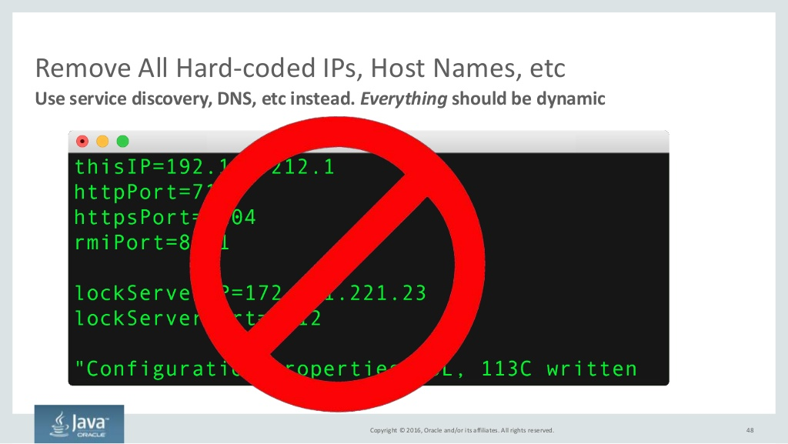
Notes:
Copyright Â© 2016, Oracle and/or its affiliates. All rights reserved. Remove All Hard-coded IPs, Host Names, etc 48 Use service discovery, DNS, etc instead. Everything should be dynamic

Slide 49
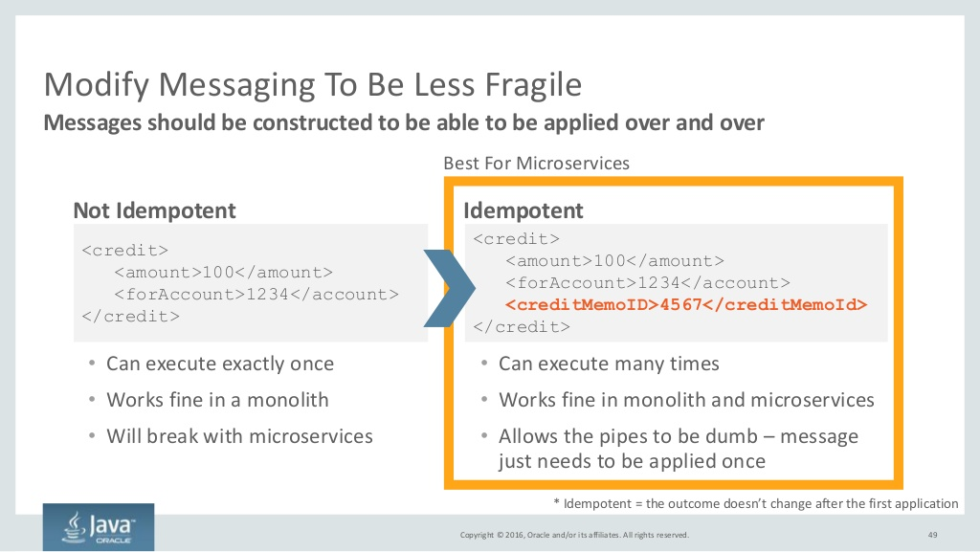
Notes:
Copyright Â© 2016, Oracle and/or its affiliates. All rights reserved. <credit&> <amount&>100</amount&> <forAccount&>1234</account&> <creditMemoID&>4567</creditMemoId&> </credit&> <credit&> <amount&>100</amount&> <forAccount&>1234</account&> </credit&> Modify Messaging To Be Less Fragile 49 Messages should be constructed to be able to be applied over and over Not Idempotent Idempotent - Can execute exactly once - Works fine in a monolith - Will break with microservices - Can execute many times - Works fine in monolith and microservices - Allows the pipes to be dumb  message just needs to be applied once Best For Microservices * Idempotent = the outcome doesnt change after the first application

Slide 50
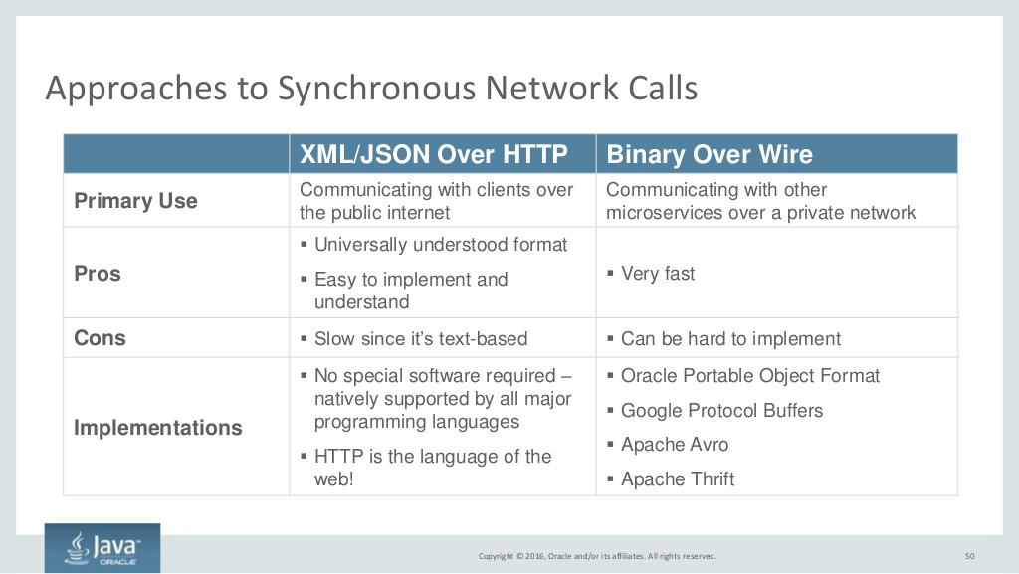
Notes:
Copyright Â© 2016, Oracle and/or its affiliates. All rights reserved. Approaches to Synchronous Network Calls 50 XML/JSON Over HTTP Binary Over Wire Primary Use Communicating with clients over the public internet Communicating with other microservices over a private network Pros ï§ Universally understood format ï§ Easy to implement and understand ï§ Very fast Cons ï§ Slow since its text-based ï§ Can be hard to implement Implementations ï§ No special software required  natively supported by all major programming languages ï§ HTTP is the language of the web! ï§ Oracle Portable Object Format ï§ Google Protocol Buffers ï§ Apache Avro ï§ Apache Thrift

Slide 51

Notes:
Copyright Â© 2016, Oracle and/or its affiliates. All rights reserved. REST: Representational State Transfer 51 Strongly associated with microservices but not a technical requirement HTTP REST XML or JSON HTTP Response Codes - Much simpler alternative to SOAP - Uses GET, POST, PUT, DELETE, etc  just like web browsers do - Synchronous inter-microservice communication often occurs over binary - Can version APIs - /v1.2/customer - Can use XML or JSON  XML is often better - supports XPath, CSS selectors - Can&#x27;t generate strongly typed stubs REST =

Slide 52

Notes:
Copyright Â© 2016, Oracle and/or its affiliates. All rights reserved. Microservices Requires a Higher Level of REST Use 52 Oracle fully supports level 3 - Level 0  Use HTTP as a tunneling mechanism only  Interact with /OrderService  Use HTTP GET/POST only - Level 1  Start requesting individual resources  Interact with /OrderService/12345 - Level 2  Start using HTTP verbs - HTTP GET/POST/PUT/DELETE/etc  Responses come back using correct HTTP codes  e.g. HTTP 409 for a conflict - Level 3  Application itself tells client how to interact with it - similar to hyperlinks in a web page  <link rel = &delete& uri = &/OrderService/12345/delete&/&> under <order id=&12345&&>

Slide 53

Notes:
Copyright Â© 2016, Oracle and/or its affiliates. All rights reserved. Message Compatibility Across Versions 53 Design for backwards compatibility <product&> <id&>329340224</id&> </product&> API Application Datastore Infrastructure v1.1 API Application Datastore Infrastructure v1.2 Send update to Product Catalog microservice <product&> <id&>329340224</id&> <shipToStore&>true</shipToStore&> </product&>Send update to Product Catalog microservice but v1.2 adds a new required property Dont make properties required! Assume any given microservice has two or more different versions running concurrently. Build for backwards compatibility

Slide 54

Notes:
Copyright Â© 2016, Oracle and/or its affiliates. All rights reserved. Technical Prerequisites 54

Slide 55

Notes:
Copyright Â© 2016, Oracle and/or its affiliates. All rights reserved. Requirements for Microservices Implementation 55 Microservices Security ScalingMonitoring Eventing LoggingMessaging Service Discovery ConfigurationSecurity Service Registry API GatewayAPI Load Balancer Generally Recommended for Microservices

Slide 56

Notes:
Copyright Â© 2016, Oracle and/or its affiliates. All rights reserved. Key Microservices Technology  Service Registry - Manages the lifecycle of each microservice endpoint  Newly-instantiated endpoints register with Service Registry  Service Registry continually polls each endpoints health - Aware of tenants, microservice versions, and environments  Health checking and selecting the most appropriate endpoint are very much dependent upon the tenant, version, and environment  Can query for an endpoint based on those attributes 56 API Load Balancer Whats the best endpoint to use for microservice X? Client HTTP request Service Registry Java SE Cloud Service (instances 1...N) Node Cloud Service (instances 1...N) Compute Cloud Service (instances 1...N) Runtime X (instances 1...N) Just added a new endpoint Runtime InstancesMicroservice Infrastructure Java Cloud Service (instances 1...N)

Slide 57

Notes:
Copyright Â© 2016, Oracle and/or its affiliates. All rights reserved. Key Microservices Technology  API Load Balancer - Matches each request to the best endpoint - Queries Service Registry to determine the best endpoint - Ideally stateless  looks up the best endpoint for each HTTP request - Uses load balancer or web server as the core. Typical implementations are customized Oracle Traffic Director, Nginx, or Apache mod_rewrite - Handles logging, request rate limiting, authentication 57 API Load Balancer Whats the best endpoint to use for microservice X? Client HTTP request Service Registry Java SE Cloud Service (instances 1...N) Node Cloud Service (instances 1...N) Compute Cloud Service (instances 1...N) Runtime X (instances 1...N) Just added a new endpoint Runtime InstancesMicroservice Infrastructure Java Cloud Service (instances 1...N)

Slide 58

Notes:
Copyright Â© 2016, Oracle and/or its affiliates. All rights reserved. API Gateways Load Balance and Aggregate Responses 58 API gateways provide a &backend for each frontend& Client Public Internet Microservice Microservice Microservice Microservice Microservice Microservice Data Center API Gateway Microservice Microservice Microservice - Builds a XML or JSON response for each type of client  web, mobile, etc - Asynchronously calls each of the N microservices required to build a response - Handles security and hides back-end - Load balances - Applies limited business logic - Meters APIs - Logs centrally - Common solutions: Netty, Vertex, Nginx, Kong, Apigee

Slide 59

Notes:
Copyright Â© 2016, Oracle and/or its affiliates. All rights reserved. 59 API Load Balancer vs. API Gateway ï¼ Matches each request to the best endpoint API Load Balancer ï¼ Queries Service Registry to determine the best endpoint ï¼ Handles logging, request rate limiting, authentication ï¼ Matches each request to the best endpoint ï¼ Queries Service Registry to determine the best endpoint ï¼ Handles logging, request rate limiting, authentication ï¼ Aggregates the responses of many microservices API Gateway API Load Balancers are missing aggregation but... Its best to build a microservice that does aggregation. Keep the API Load Balancer or Gateway as free of business logic as possible

Slide 60

Notes:
Copyright Â© 2016, Oracle and/or its affiliates. All rights reserved. Service Discovery  Generally Not a Problem With Monoliths 60 Requirements ï§ Must resolve: - Host/port - Version for each microservice ï§ Must be discoverable Because ï§ Many microservices in an environment ï§ Many environments ï§ Many versions of each microservice ï§ Hosts/ports can change quickly ï§ Its not practical to manage by hand Approaches Include ï§ Plain DNS - limited to IP only ï§ SRV DNS records - gives IP + port ï§ Hierarchical namespaces ï§ Instance tagging in the cloud Solutions Include ï§ Any DNS provider ï§ Consul ï§ Zookeeper ï§ Custom coding to search instance tags

Slide 61

Notes:
Copyright Â© 2016, Oracle and/or its affiliates. All rights reserved. Microservices Requires Robust Messaging 61 Both traditional durable messaging and non-durable eventing Microservice Microservice Microservice Microservice - Message broker can buffer messages until the consumer is able to process them  prevents synchronous coupling which leads to outages - Smart endpoints, dumb pipes is the philosophy of microservices  messaging should just pass messages. Not manipulate them - Should support a variety of communication patterns including one-way requests and publish-subscribe Why Use Messaging? Requirements for Messaging Types of Messaging Normal Messaging - Durable, ordered - Relatively low throughput - Usually brokered - Often used to keep the data across different microservices in sync, as each microservice has its own data store Eventing - Non-durable, un-ordered - Very high throughput - Usually non-brokered - Often used to distribute notification events  scale up, scale down, etc

Slide 62

Notes:
Copyright Â© 2016, Oracle and/or its affiliates. All rights reserved. Circuit Breakers Prevent Cascading Failures - Rule #1 of microservices  avoid coupling!  Synchronous = two systems are coupled  Asynchronous = no coupling - Cascading failures happen when request-handling threads are waiting on a response from a remote system - Circuit breakers make synchronous calls from another thread pool to avoid binding up request-handling threads - Hystrix (Java-based) is well-known and solves this problem 62 Cascading failures are more common with microservices

Slide 63

Notes:
Copyright Â© 2016, Oracle and/or its affiliates. All rights reserved. Emit Logs as Event Streams 63 Cant do anything with log files sitting on a containers local storage volume Log Entry Log Entry Log Entry Log Entry Log Entry Log Entry Log Entry Log Entry Log Entry Log Entry Log Entry Log Entry Log Entry Log Entry Log Entry Log Entry Container Instance of Application Log Entry Log Entry Log Entry Log Entry Log Entry Log Entry Log Entry Log Entry Log Entry Log Entry Log Entry Log Entry Log Entry Log Entry Log Entry Log Entry Container Instance of Application Log Entry Log Entry Log Entry Log Entry Log Entry Log Entry Log Entry Log Entry Log Entry Log Entry Log Entry Log Entry Log Entry Log Entry Log Entry Log Entry Container Instance of Application Capture, Aggregate, Search, Troubleshoot, etc

Slide 64

Notes:
Copyright Â© 2016, Oracle and/or its affiliates. All rights reserved. Private Subnet Security: Requires New Paradigms to Properly Secure 64 More microservices, more principals, more technologies, more everything Client Microservice Microservice API Gateway Public Internet Data Center - HTTPS - HTTPS Basic - Client certificates - Public/private keys - SAML - OpenID Connect Datastore Datastore Private Subnet - HTTPS - Must authorize and authenticate every single principal  best to use common approach - Monolithic apps typically do authentication and authorization on their own - Secure every single remote network call - Use network segmentation to isolate microservices from each other

Slide 65

Notes:
Copyright Â© 2016, Oracle and/or its affiliates. All rights reserved. Microservices Complicates Testing 65 More code, more microservices to test Acceptance Testing Usability Testing Component Testing Did we build the right thing? Do business requirements make sense? Performed manually directly by business users Entire system is tested using end- clients How usable is the system? Will end- users like it? Is it fast enough? Performed manually by business users Entire system is tested using end- clients Does each microservice work in isolation? Is it fast enough? Performed automatically with each microservice release Each microservice is tested in isolation. Dependencies stí out Does each fragment of code work in isolation? Performed automatically with each build Each method, or similar fragment is captured Unit Testing Frequency of Testing

Slide 66

Notes:
Copyright Â© 2016, Oracle and/or its affiliates. All rights reserved. What/How To Monitor 66 Monitoring a monolith is relatively easy  one app. Microservices = many apps Requirements for Monitoring Microservices 1. Monitor throughput, performance, and business metrics 2. Trace each end-request through every microservice  end-to-end 3. Track the health of downstream dependencies 4. Monitor each process, OS, host, etc Dropwizard Metrics Popular Tooling

Slide 67

Notes:
Copyright Â© 2016, Oracle and/or its affiliates. All rights reserved. Containers Make Microservices Easier 67 Helpful to microservices but not a requirement Hardware Hypervisor VM 1 OS App VM 2 OS App Hardware Virtualization Hardware Operating System Hypervisor VM 1 OS App VM 2 OS App Para-virtualization Hardware Operating System Container 1 App Container 2 App Containers - #1 value  app packaging - Microservices doesn&#x27;t rely on containers but they do help:  Higher density  Easy to start/stop  Portability - Containers are lightweight, just like microservices themselves

Slide 68

Notes:
Copyright Â© 2016, Oracle and/or its affiliates. All rights reserved. Many See Containers As the Standard 68 Four main use cases Hardware Operating System Container App Container App Container App Container App Container App Container App Container App Container App Container App Hardware Operating System Container App Container App Container App Container App Container App Container App Container App Container App Container App Hardware Operating System Container App Container App Container App Container App Container App Container App Container App Container App Container App Hardware Operating System Container App Container App Container App Container App Container App Container App Container App Container App Container App Hardware Operating System Container App Container App Container App Container App Container App Container App Container App Container App Container App Hardware Operating System Container App Container App Container App Container App Container App Container App Container App Container App Container App Hardware Operating System Container App Container App Container App Container App Container App Container App Container App Container App Container App Hardware Operating System Container App Container App Container App Container App Container App Container App Container App Container App Container App Application Packaging Continuous Integration DIY PaaS Infrastructure Consolidation Neatly package applications and supporting environment in immutable, portable containers All changes to an app are contained in one immutable container image. Container is tested and deployed as one atomic unit Get infrastructure utilization up to 100% (vs 5-10% with VMs) due to over-subscription of resources and near bare metal performance. Build a simple PaaS by wiring up containers to a load balancer. New code, patches, etc pushed as new immutable containers.

Slide 69

Notes:
Copyright Â© 2016, Oracle and/or its affiliates. All rights reserved. Containers Should Be Immutable 69 Patches to System Software New Version of Application Configuration Changes Build and deploy a new container Never touch a container thats already been built

Slide 70

Notes:
Copyright Â© 2016, Oracle and/or its affiliates. All rights reserved. One Instance Per Container is Typical - Best to run one instance (unique host/port combination) per container - Running multiple instances of the same application or different applications will make scheduling very difficult - Expose one port per container 70 Physical Host Operating System Container App Container App Just One Per Container

Slide 71

Notes:
Copyright Â© 2016, Oracle and/or its affiliates. All rights reserved. How Do You Deploy Containers to Physical Hosts? 71 The emerging space of container orchestration What Do Container Orchestration Solutions Do? - Map containers back to physical hosts, taking into account user- defined placement rules, the utilization of each host, and the needs of each container. Can be very complex - Set up overlay networking, firewalls, ensure network QoS, etc - Auto-scaling - Local and external load balancers - Service registry / discovery Host Host Host Host Host Host Host Host Host Host Container - Inventory Microserv ice - AcmeCo - v1.2 Container - Inventory Microserv ice - AcmeCo - v1.2 Container - Inventory Microserv ice - AcmeCo - v1.2 Container - Inventory Microserv ice - AcmeCo - v1.2 Container - Inventory Microserv ice - AcmeCo - v1.2 Container - Inventory Microserv ice - AcmeCo - v1.2 Container - Inventory Microserv ice - AcmeCo - v1.2 Container - Inventory Microserv ice - AcmeCo - v1.2 Container - Inventory Microserv ice - AcmeCo - v1.2 Container App Container - Inventory Microserv ice - AcmeCo - v1.2 Container - Inventory Microserv ice - AcmeCo - v1.2 Container - Inventory Microserv ice - AcmeCo - v1.2 Container - Inventory Microserv ice - AcmeCo - v1.2 Container - Inventory Microserv ice - AcmeCo - v1.2 Container - Inventory Microserv ice - AcmeCo - v1.2 Container - Inventory Microserv ice - AcmeCo - v1.2 Container - Inventory Microserv ice - AcmeCo - v1.2 Container - Inventory Microserv ice - AcmeCo - v1.2 Container App Many Containers Host Host Host Host Host Host Host Host Host Host Many Hosts Docker Swarm Emerging space. Solutions are very early and lack any real notion of an application. Still very much infrastructure-focused

Slide 72

Notes:
Copyright Â© 2016, Oracle and/or its affiliates. All rights reserved. Artifacts Are Now Immutable Containers  Not EARs, WARs 72 Containers can have anything in them and are highly portable Hardware Operating System Hypervisor VM 1 VM 2 Current Hardware Operating System Container 1 Container 2 Cloud Native - No more installing a JVM, app server, and then deploying the artifacts to them - Build the container once, deploy it anywhere. Can include complex environment variables, scripts, etc - Containers should be free of state and configuration - Containers should not assume they are able to write to a persistent local file system OS App Server EAR/WAR OS App Server EAR/WAR The Artifact You Deploy

Slide 73

Notes:
Copyright Â© 2016, Oracle and/or its affiliates. All rights reserved. Constantly Deploy Each Microservice 73 No need to batch together many changes to single app One Application Many Microservices  Deploy Many Times/Day API Application Datastore Infrastructure Inventory Microservice API Application Datastore Infrastructure Payment Microservice API Application Datastore Infrastructure Profile Microservice API Application Datastore Infrastructure Product Catalog Microservice By definition, each microservice can be written, built, and deployed independently User Interface Application Datastore Infrastructure Deploy Constantly  Even HourlyDeploy Quarterly Long, serial process to deploy anything

Slide 74

Notes:
Copyright Â© 2016, Oracle and/or its affiliates. All rights reserved. Run Many Versions of the Same Microservice Concurrently 74 Monolithic Application v1.1 Microservice A Microservice A Microservice A Microservice A Microservice AMicroservice B v1.1 Microservice A Microservice A Microservice A Microservice A Microservice A Microservice A Microservice A Microservice A Microservice A Microservice AMicroservice B v1.2 Microservice A Microservice A Microservice A Microservice A Microservice A Run only one version of the same application in the same environment Run many versions of each microservice in the same environment Microservice A v1.2 Microservice A v1.1

Slide 75

Notes:
Copyright Â© 2016, Oracle and/or its affiliates. All rights reserved. Application Containers  Use What You Have Today 75 Characteristics of Microservices- friendly Application Server Characteristics of Existing Application Server - Run a smaller, microservice that does one thing really well - Few features - External dependency management - Many instances per host - Stateless - Run a very large, complicated monolithic application - Many advanced features - Integrated dependency management - Few instances per host - Stateful Run whatever works best  few firm requirements

Slide 76

Notes:
Copyright Â© 2016, Oracle and/or its affiliates. All rights reserved. How Oracle Products Support Microservices 76

Slide 77

Notes:
Copyright Â© 2016, Oracle and/or its affiliates. All rights reserved.Copyright Â© 2016, Oracle and/or its affiliates. All rights reserved. Oracles Microservices Strategy Oracles Microservices Roadmap Today With Oracle Products Runtime Management/Logging/Alerting Messaging Datastore API Gateway/Load Balancer Central Source of Truth Infrastructure Build/Deploy 77 Container Orchestration Service Discovery Eventing Configuration State Planned - Oracle Cloud State Service Planned - Oracle Cloud Config Service Planned - Runtime - Jersey + Grizzly Planned - Oracle Cloud Eventing Service Oracle Messaging Cloud Service Oracle Management Cloud Service Oracle Database or NoSQL Cloud Service Oracle Cloud Planned - Oracle Microservices Platform Oracle Developer Cloud Service Planned - Oracle Microservices Platform Planned - Oracle Microservices Platform Planned - Oracle Microservices Platform Oracle Coherence or Oracle WebLogic Oracle Coherence Oracle WebLogic, Node, Java SE, etc Oracle Coherence Oracle Messaging Cloud Service Oracle Management Cloud Service Oracle Database or NoSQL Cloud Service Oracle Cloud Oracle App Container Cloud Service Oracle Developer Cloud Service Oracle App Container Cloud Service Oracle Coherence Oracle App Container Cloud Service

Slide 78

Notes:
Copyright Â© 2016, Oracle and/or its affiliates. All rights reserved. An All-New Microservices Platform From Oracle Oracle Confidential  Internal/Restricted/Highly Restricted - Config - State - Eventing - Messaging - Logging - Monitoring - Database - NoSQL - Caching - Integration - Big Data - Mobile - Process - Developer Infrastructure Agnostic High Availability Hybrid Cloud Placement Constraints High Density Internal Load Balancing Rolling Upgrades Rollbacks Blue/Green Releases Canary Testing Health MonitoringService DiscoveryStateless Support Stateful Support Microservices Platform Language-specific Tooling Install Platform On Any IaaS, On Or Off Premise (future)Consume Platform as PaaS on Oracle Cloud Oracle Public Cloud Oracle Public Cloud Machine AllNew Services Available for Consumption Inside the Platform Runtime Light/fast Jersey-based Easy Packaging Copyright Â© 2016, Oracle and/or its affiliates. All rights reserved. New! 78

Slide 79

Notes:
Copyright Â© 2016, Oracle and/or its affiliates. All rights reserved. Using Application Container Cloud Service For Microservices 79 A modern platform for lightweight application development Database Cloud Service Oracle Cloud Application Container Cloud Service NoSQL Cloud Service Oracle Management Cloud - Management/Logging/Alerting Messaging Cloud Service Caching Cloud Service for State Java SE Cloud Service API Load Balancer Service Discovery Configuration Node Cloud Service Other Polyglot Runtimes Bring Your Own Container Jersey + Grizzly Docker Containers Container Placement DeveloperCloudService

Slide 80

Notes:
Copyright Â© 2016, Oracle and/or its affiliates. All rights reserved. Introducing Oracle App Container Cloud Service 80 Key Features - Useful for any Java, Node.js, or polyglot runtime - IDE Choice - JDeveloper, Eclipse, NetBeans - and API access - Continuous integration with Oracle Developer Cloud Service - Cloud tooling for lifecycle management - Integrated load balancer, support for service discovery - Bring-your-own-container model supported shortly Benefits - Self-service application platform with advanced cloud tools - Secure, Highly Available with Clustering - Fully automated provisioning, patching, backup, and recovery Java SE Node Your Own Container

Slide 81

Notes:
Copyright Â© 2016, Oracle and/or its affiliates. All rights reserved. JAX-RS: The Java API for RESTful Web Services 81 Oracle is a spec lead @Path(&/atm/{cardId}) public class AtmService { @GET @Path(&/balance) @Produces(&text/plain) public String balance( @PathParam(&cardId&) String card, @QueryParam(&pin&) String pin) { Client client = ClientFactory.newClient(); String balance = client.target(&http://xxxx/atm/{cardId}/ balance&) .pathParam(&cardId&, &1234567890123456&) .queryParam(&pin&, &1111&) .request(&text/plain&) .get(String.class); Server-side Code Simply annotate Java code to expose as REST Client-side Code Use REST without having to parse text Updated as JSR 339 in 2013 - 2.0 Part of Java EE 7 Spec |Originally defined in JSR 311 - 1.0 Part of Java EE 6 Spec

Slide 82

Notes:
Copyright Â© 2016, Oracle and/or its affiliates. All rights reserved. Jersey: The Reference Implementation of JAX-RS - Oracle sponsored open source - Implements the JSR 311 specification - Contains  Standalone server  Client  JAXB/JSON support 82 Oracle continues to lead the spec

Slide 83

Notes:
Copyright Â© 2016, Oracle and/or its affiliates. All rights reserved. Grizzly: High Performance I/O - Oracle sponsored open source - Allows developers to take advantage of the Java NIO to provide very fast inter-process communication - Brings non-blocking sockets to the protocol processing layer  Support for non-blocking HTTP processing - WebSocket Support - APIs make non-blocking interactions simple 83 Great for inter-process communication

Slide 84

Notes:
Copyright Â© 2016, Oracle and/or its affiliates. All rights reserved. 84 Using WebLogic + Java EE For Microservices A proven, enterprise-grade platform for application development Database Cloud Service Oracle Cloud Oracle Compute Cloud Service NoSQL Cloud Service Oracle Management Cloud - Management/Logging/Alerting Messaging Cloud Service Caching Cloud Service For State, Configuration, Service Discovery DeveloperCloudService Oracle Traffic Director Docker Containers Container Placement WebLogic Multi-tenant WebLogic Multi-tenant Jersey + Grizzly Jersey + Grizzly WebLogic Partition

Slide 85

Notes:
Copyright Â© 2016, Oracle and/or its affiliates. All rights reserved. Java EE Platform Supports Microservices - Standards based infrastructure  Prescribed, validated set of APIs and services  WAR file deployment for service boundary - Enables development of thin Microservices  Assemble application code and resources only  APIs and implementation libraries supplied by platform - Freedom to choose best service topology  One service per server, multiple services per server  One server per container/host  Multiple containers/servers per host 85 JAX-RS CDI HTTP/S WebSocket EJB JPA JSON JDBC Ï S Ï S Data Store Data Store JAX-RS CDI HTTP/S WebSocket EJB JPA JSON JDBC Ï S Ï S PDB PDB

Slide 86

Notes:
Copyright Â© 2016, Oracle and/or its affiliates. All rights reserved. - Java EE Platform Support  With latest Java language support - Fully automatable infrastructure  Scriptable provisioning, configuration, deployment supporting code-as- infrastructure  REST API, WLST, JMX  Callable from Maven, Gradle, Arquillian  Easily incorporated into Continuous Integration and Delivery workflows - Flexible placement models  Single server, multiple servers, clusters of servers - Diverse datastore options  Traditional multi-vendor relational database support  Integrated Oracle Database 12c pluggable database support as independent data stores for services  Simple configuration for Document/Graph databases  Container, application, embedded application scoped database resources 86 WebLogic Supports Microservices (and then some!)

Slide 87

Notes:
Copyright Â© 2016, Oracle and/or its affiliates. All rights reserved. 87 Partition is now a first-class object WebLogic Multi Tenant WebLogic JVM Application OS Process WebLogic JVM Application OS Process WebLogic JVM Application OS Process WebLogic JVM Application OS Process Operating System Instance Standard WebLogic Single-tenant Multi-tenant  strong isolation between tenants Multi Tenant WebLogic WebLogic JVM OS Process WebLogic JVM OS Process Operating System Instance Application 2 Application 2 Partition 2Partition 2 Application 1 Application 1 Partition 1Partition 1

Slide 88

Notes:
Copyright Â© 2016, Oracle and/or its affiliates. All rights reserved. WebLogic Multi Tenant is Perfect for Microservices - Each microservice instance can have its own light-weight WebLogic container-like partition - Easily move partitions between WebLogic hosts - Each partition is exceptionally light - Each WebLogic host can support hundreds of partitions 88 Similar to Oracle Database pluggable/container databases WebLogic JVM Microservice OS Process Operating System Instance Microservice Microservice Microservice Microservice Microservice Microservice Microservice Microservice Microservice Microservice Microservice Microservice Microservice Microservice Multi Tenant WebLogic

Slide 89

Notes:
Copyright Â© 2016, Oracle and/or its affiliates. All rights reserved. WebLogic Runs Great on Docker - Build oracle/weblogic:12.1.3- dev image - Start 3 WebLogic Server Containers in seconds - View status 89 $ docker run p 17001:7001 oracle/weblogic:12.1.3-dev 1 2 3

Slide 90

Notes:
Copyright Â© 2016, Oracle and/or its affiliates. All rights reserved. Other Supporting Products from Oracle 90Copyright Â© 2016, Oracle and/or its affiliates. All rights reserved.

Slide 91

Notes:
Copyright Â© 2016, Oracle and/or its affiliates. All rights reserved. Oracle Coherence  Oracles Distributed Data Grid - Reliable in-memory key-value store  Dynamically scalable  Scale processing with data  Flexible topology support - Java, .NET, C++, REST, Memcached, Jcache client support - In-place distributed processing - Queries & continuous queries - Map-reduce aggregation - Event notification / event programming model - Distributed Lambdas and Streams 91 Architected for microservice state management

Slide 92

Notes:
Copyright Â© 2016, Oracle and/or its affiliates. All rights reserved. Oracle Messaging Cloud Is Perfect for Microservices 92 Implements AMQP standard Standardized Interfaces REST JMS Message push over HTTP Versatile Oracle Cloud On Premise Hybrid Delivery Choices Pull Push Filter Reliability Mechanisms Transactions Acknowledgements Durable subscriptions

Slide 93

Notes:
Copyright Â© 2016, Oracle and/or its affiliates. All rights reserved. Oracle Management Cloud Services  Initial Offerings Application Performance Monitoring Improve End-User Experience and System Performance; Diagnose Performance Issues Faster Log Analytics Extract Value from Logs by Collecting, Correlating, and Searching Any Kind of Log Data; Quickly Discover Anomalies IT Analytics Make Critical Decisions About Your IT Estate; Plan For Growth, Run What-If Analyses, Compare Resource Usage 93

Slide 94

Notes:
Copyright Â© 2016, Oracle and/or its affiliates. All rights reserved. Oracle Datastore Options  Offered On Premise and In Cloud 94 DESCRIPTION Supports JSON, XML, CLOBs, BLOBs, and multi-media. Accessible over client-specific APIs, REST Distributed key/value pairs, schema- less, nearly ACID compliant, scale out. Berkeley DB behind the scenes Distributed data grid that supports grid-side processing PRODUCTS Fraud Detection CATEGORY RDBMS Key/Value Stores Object Data Grid

Slide 95

Notes:
Copyright Â© 2016, Oracle and/or its affiliates. All rights reserved. Pluggable Databases - Container Database  Multi-tenant database that includes zero, one or many pluggable databases  Upgrades, etc are performed against container - Pluggable Database  A full database to the client except that behind the scenes it doesnt have its own controlfiles, redo logs, undo, etc  Just a collection of datafiles and tempfiles to handle its own objects, including its own data dictionary  Can easily move Pluggable Databases from one container to another 95 One Container Database per application, one Pluggable Database per microservice

Slide 96

Notes:
Copyright Â© 2016, Oracle and/or its affiliates. All rights reserved. Oracle Database: Simple Oracle Document Access (SODA) - Enable schemaless development on top of an Oracle Database  Provide a simple NoSQL-style API for working with documents - Make it easy to use Oracle as a NoSQL-style document store - Supports all common application development environments - Supports SQL! - Works with Oracle Database tooling  backup, restore, security, etc 96 NoSQL backed by Oracle Database POST /DBJSON/SCOTT/CUSTOMERS?action=query HTTP/1.0 Content-Type: application/json Body: { &company& : Oracle, &$or& : {&$startsWith& : {&name&: &Melissa&}}} select &JKEY&,VERSION&, &LAST_MODIFIED, CREATED from &SCOTT&.CUSTOMERS& where JSON_EXISTS( &JVALUE&, &#x27;$?( $.company == $B0 && ( $.name starts with $B2))&#x27; PASSING OracleAS &B0& ,MelissaAS B1) { &items&: [ { &id&: &09615A98B2B941AF94D84FD44D04AB9C&, &etag&: &D78FBD B879E&, &lastModified&: &2015-02-10T01:15:13.631231, &created&: &2015-02-10T01:15:13.631231 }, {more records...} ], &hasMore&: true, &count&: 4, &offset&: 0, &limit&: 4 } RESTSQLJSON

Slide 97

Notes:
Copyright Â© 2016, Oracle and/or its affiliates. All rights reserved. SODA For Java - Provides:  Connection to the database (replaces JDBC!)  Collection Management  CRUD operations  Query-by-Example  Utility and control functions - SODA for Java applications can use a JDBC connection to talk to the database - SODA for Java is transactional  Supports Hybrid model with JDBC and SODA based operations 97 Native library for Java // Create a Connection OracleRDBMSClient client = new OracleRDBMSClient(); OracleDatabase database = client.getDatabase(conn); // Now create a collection OracleCollection collection = database.getDatabaseAdmin().createCollection(MyCollection); // Create a document OracleDocument document = database.createDocumentFromString(&{ name& : Alexander }); // Next, insert it into the collection OracleDocument insertedDocument = collection.insertAndGet(document); // Get the key of the inserted document String key = insertedDocument.getKey(); // Get the version of the inserted document String version = insertedDocument.getVersion();

Slide 98

Notes:
Copyright Â© 2016, Oracle and/or its affiliates. All rights reserved. SODA For REST - Standard REST based model - CRUD operations map to HTTP Verbs  Create / Update : PUT / POST  Retrieve : GET  Delete : DELETE - Other operations, such as Query by Example, Bulk Insert and Indexing are mapped to variants of POST - JSON document forms the payload of the HTTP Request or Response - Stateless model, no transaction support - Implemented as a Java Servlet 98 Can be invoked from any programming language GET /DBSODA/schema List all collections in a schema GET /DBSODA/schema/colle ction Get all objects in collection GET /DBSODA/schema/colle ction/id Get specific object in collection PUT /DBSODA/schema/colle ction Create a collection if necessary PUT /DBSODA/schema/colle ction/id Update object with id POST /DBSODA/schema/colle ction Insert object into collection POST Find objects matching filter in

Slide 99

Notes:
Copyright Â© 2016, Oracle and/or its affiliates. All rights reserved. SODA For REST Architecture 99 Clean architecture ï§ Data stored in Oracle Database as JSON documents ï§ App Developer make standard HTTP(S) calls to SODA for REST API Oracle DatabaseHTTP(S) client Oracle REST Data Services SODA 4 REST Generated SQL Transform JSONPass thruJSON JSON URI JAVA Container

Slide 100

Notes:
Copyright Â© 2016, Oracle and/or its affiliates. All rights reserved. Summary 100

Slide 101

Notes:
Copyright Â© 2016, Oracle and/or its affiliates. All rights reserved. Problems to Solve With Microservices 101 Many, very sticky problems to solve

Slide 102

Notes:
Copyright Â© 2016, Oracle and/or its affiliates. All rights reserved. Microservices Adoption Patterns 102 Start with a monolith Adopt Microservices (Only if the monolith gets too big and youve met the other prerequisites)

Slide 103

Notes:
Copyright Â© 2016, Oracle and/or its affiliates. All rights reserved. Microservice Takeaways for Enterprises 103 The term microservices is probably a passing fad, but there is real business value Technical Prerequisites Ability to Execute Time | Competency | Resources Architectural Prerequisites Non-technical Prerequisites Constraints:

Slide 104

Notes:
Copyright Â© 2016, Oracle and/or its affiliates. All rights reserved. Remember: Microservices Are Not a Silver Bullet &There is no single development, in either technology or management technique, which by itself promises even one order of magnitude [tenfold] improvement within a decade in productivity, in reliability, in simplicity. &We cannot expect ever to see two-fold gains every two years& in software development, like there is in hardware development (Moore&#x27;s law) 104 Its probably best to stick with monoliths

Slide 105

Notes:
Copyright Â© 2016, Oracle and/or its affiliates. All rights reserved. 105

Slide 106


Slide 107


